Slide 1
Statistical Tests
PhD Course

Slide 2

Checking on elm trees that were planted many years ago along a county road, a county official obtained the following arrangement of healthy, H, and diseased, D, trees:
H H H H D D D H H H H H H H D D H H D D D D
Test at the ε= 0.05 significance level whether this arrangement may be regarded as random.
We begin by stating our hypotheses:
H₀ : Arrangement is random
H₁ : Arrangement is not random

Slide 3
We apply the RUN test:
H H H H D D D H H H H H H H D D H H D D D D
The number of runs in the sequence is R=6.
n₁ = 13 (number of H), and n₂ = 9 (number of D)

Slide 4
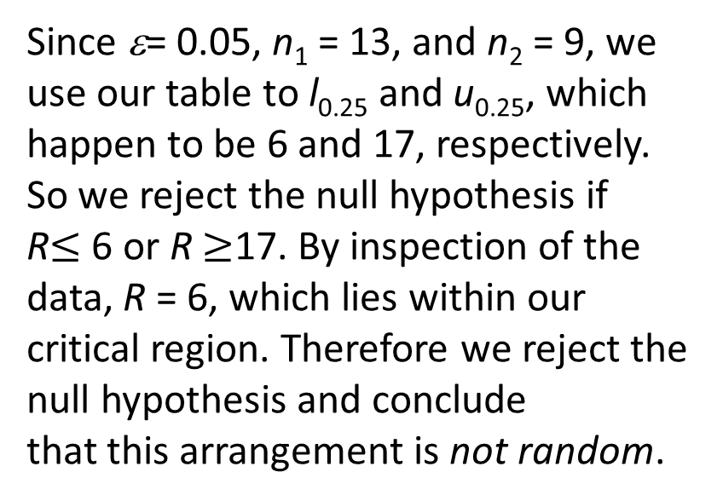
Since ε= 0.05, n₁ = 13, and n₂ = 9, we use our table to l_{0.25} and u_{0.25}, which happen to be 6 and 17, respectively. So we reject the null hypothesis if
R$≤$ 6 or R $≥$17. By inspection of the data, R = 6, which lies within our critical region. Therefore we reject the null hypothesis and conclude
that this arrangement is not random.

Slide 5

Suppose we flip a coin n=15 times and come up with the following arrangement:
H T T T H H T T T T H H T H H
(H=head, T=tail)
Test at the ε= 0.05 significance level whether this arrangement may be regarded as random.

Slide 6
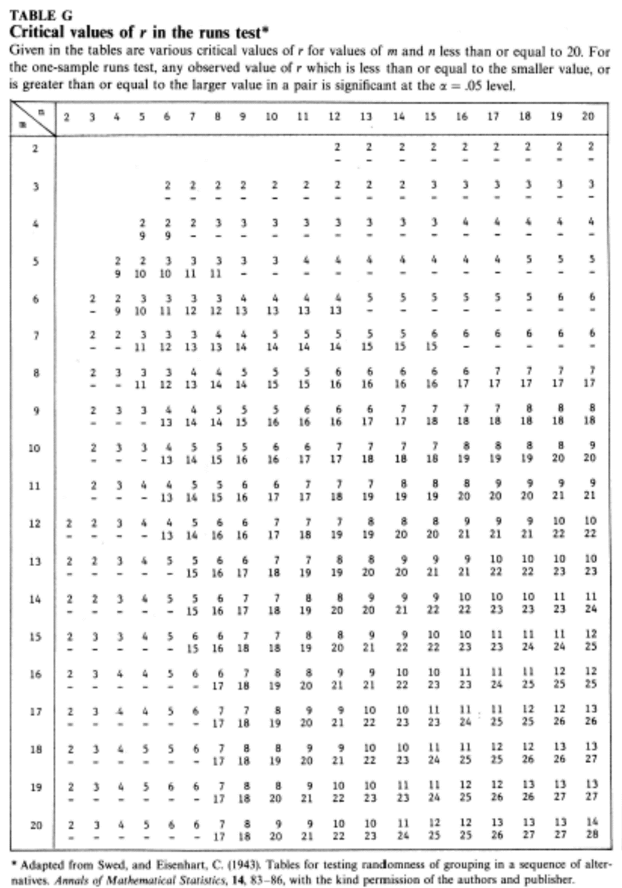
We apply the RUN test:
H T T T H H T T T T H H T H H
The number of the runs is R=7.
n₁=7,n₂=8
l_{0.25}=4
u_{0.25}=13
We accept the null hypothesis
ie the sequence is random.

Slide 7

The following is an arrangement of men, M, and women, W, lined up to purchase tickets for a rock concert:
M W M W M M M W M W M M
M W W M M M M W W M W M
M M W M M M W W W M W M
M M W M W M M M M W W M
Test for randomness at the ε= 0.05 significance level.
As always, we first state our hypotheses:
H₀ : Arrangement is random:
H₁ : Arrangement is not random:

Slide 8
We apply the RUN test:
M W M W M M M W M W M M
M W W M M M M W W M W M
M M W M M M W W W M W M
M M W M W M M M M W W M
The number of the runs is R=27
We construct our critical region using the normal distribution, which tells us to reject the null hypothesis if u <=-1.96 or u=>1.96. Since n₁ = 30, n₂ = 18, and R = 27, we get:
Because now u=1.0909 we accept the null hypothesis. (Details on the next slide.)
Since 1.0909 is outside our critical region, we fail to reject the null hypothesis, and conclude there is no real evidence to indicate the arrangement is not random.

Slide 9
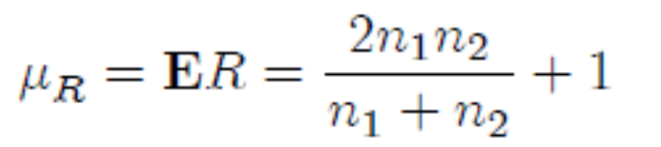
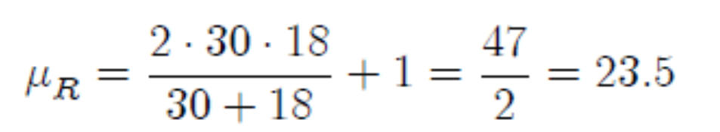

Slide 10
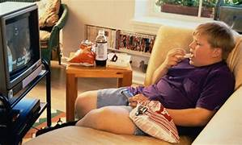
According to the Centers for Disease Control and Prevention (CDC), 17% of
school-age children in the United States are obese, while 33.8% of adults in the U.S. are obese (having a body mass index (BMI) of at least 30).
In 2005 the Marion County (Indiana) Health Department conducted a program wherein a sample of n=90147 school-age children had their heights and weights measured, allowing exact determination of their BMIs. In this survey 22% of the children measured were obese. Does this indicate that the true obesity rate for children in Marion County is different from the national average?

Slide 11
We solve the problem with binomial proportion test:

Slide 12

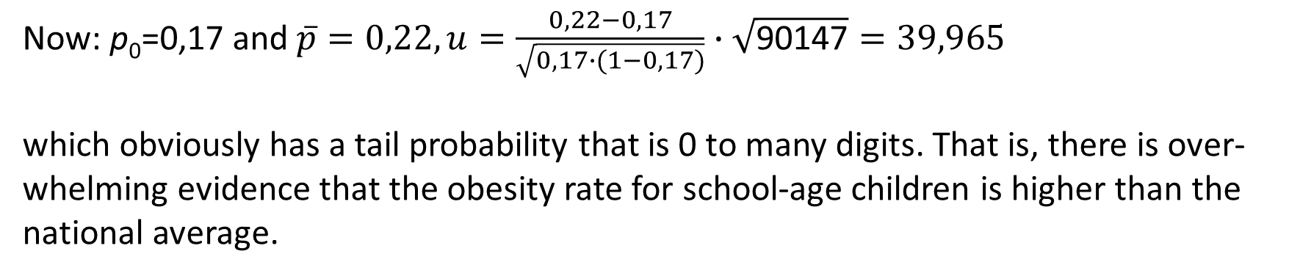
Now: p₀=0,17 and $\overline{p}=0,22, u=\frac{0,22−0,17}{\sqrt{0,17∙(1−0,17)}}∙\sqrt{\text{90147}}=39,965$
which obviously has a tail probability that is 0 to many digits. That is, there is over-whelming evidence that the obesity rate for school-age children is higher than the national average.

Slide 13

Wald-Wolfowitz Two-Sample Run Test
To determine if a new hybrid seeding produces a bushier flowering plant, following data was collected. Examine if the data indicate that new hybrid poduces larger shrubs than the current variety?
H₀: x and y populations are identical
H₁: There some difference in grith of x and y shrubs.

Slide 14
Wald-Wolfowitz Two-Sample Run Test
Consider the combined ordered data.
Test statistics R=6 (total numbers of runs). For n₁=7 and n₂=6
The critical value l_{c} and u_{c} at 5% level of significance is 3 and 12. Since l_{c}<R<u_{c} we accept H₀ and conclude that x and y have identical distribution.

Slide 15
The critical value l_{c} and u_{c} at 5% level of significance is 3 and 12. Since l_{c}<R<u_{c} we accept H₀ and conclude that x and y have identical distribution.

Slide 16
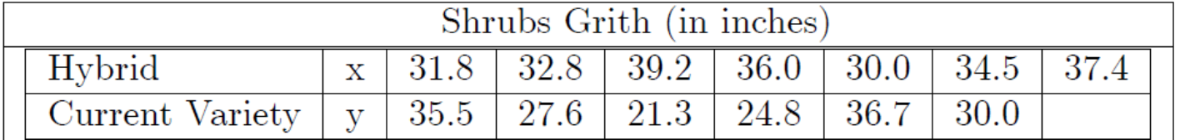
Perform a median test on the previous problem for testing that the two samples come from same population.
To determine if a new hybrid seeding produces a bushier flowering plant, following data was collected. Examine if the data indicate that new hybrid poduces larger shrubs than the current variety?
H₀: x and y populations are identical
H₁: There some difference in grith of x and y shrubs.

Slide 17
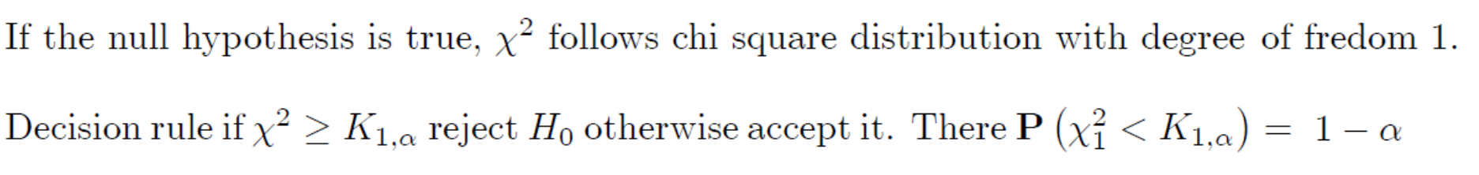
Median test for two samples
The contingency table to the median test is

Slide 18
Consider the combined ordered data.
Seventh value M=32.8 is the median of combined ordered sequence.

Slide 19
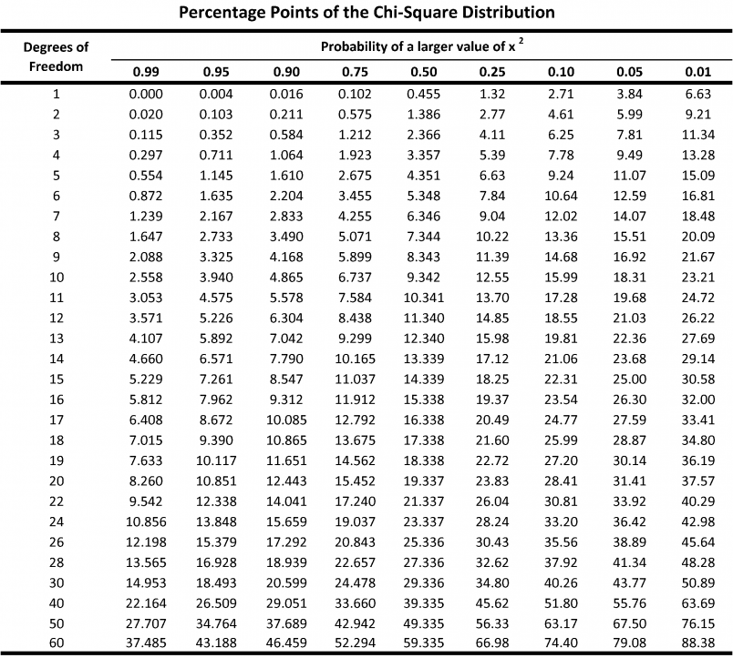
Since
H₀ is accepted. It is concluded that the two samples come from the same population. There is no significant difference in the grith of hybrid and current variety of shrub.

Slide 20
Note:
This example to demonstrate test procedure. In real situation n should be at least 20 and each cell frequency at least 5!

Slide 21
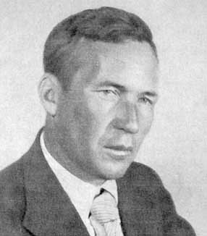
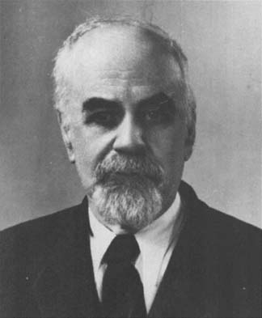
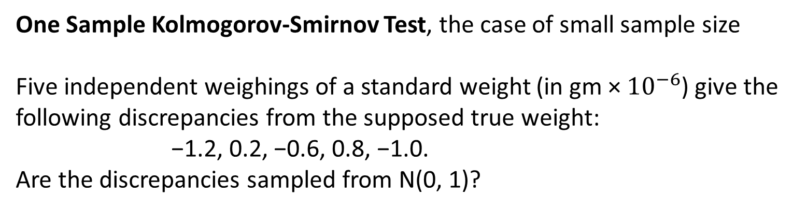
One Sample Kolmogorov-Smirnov Test, the case of small sample size
Five independent weighings of a standard weight (in gm × ${10}^{−6}$) give the
following discrepancies from the supposed true weight:
−1.2, 0.2, −0.6, 0.8, −1.0.
Are the discrepancies sampled from N(0, 1)?
V. Smirnov
1887-1974
A. N. Kolmogorov
1903-1987

Slide 22
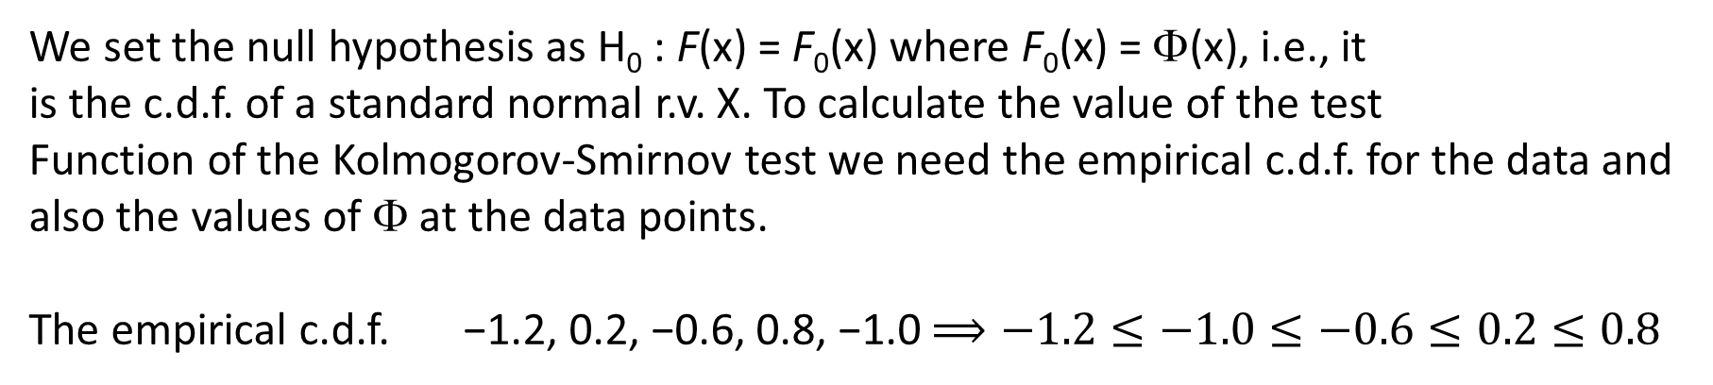
We set the null hypothesis as H₀ : F(x) = F₀(x) where F₀(x) = Φ(x), i.e., it
is the c.d.f. of a standard normal r.v. X. To calculate the value of the test
Function of the Kolmogorov-Smirnov test we need the empirical c.d.f. for the data and also the values of Φ at the data points.
The empirical c.d.f. −1.2, 0.2, −0.6, 0.8, −1.0 $⟹−1.2≤−1.0≤−0.6≤0.2≤0.8$

Slide 23
Calculations:

Slide 24
The sample size n=5, the calculated values is 0.326, critical value is 0.563.
The null hypothesis is accepted.

Slide 25

Two sample Kolmogorov-Smirnov Test
Following data represent the lifetimes of batteries for different brands:
Are these brands different with respect to average life?

Slide 26
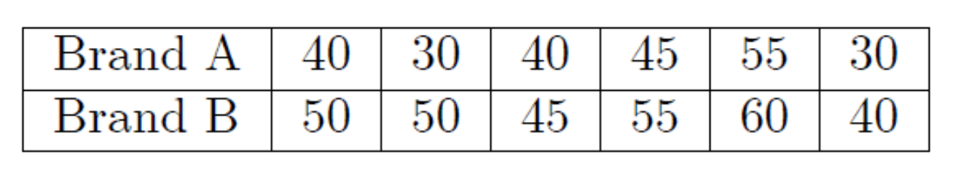
We first calculate the sample empirical distribution of two samples as follows

Slide 27
From Table the critical value for m=n=6 at level ε=0.05 is 0.33. Since the calculated value of D_{m,n} is not greater then the tabulated value, H₀ is not rejected and it is concluded that the average length of life for two brands is the same.

Slide 28
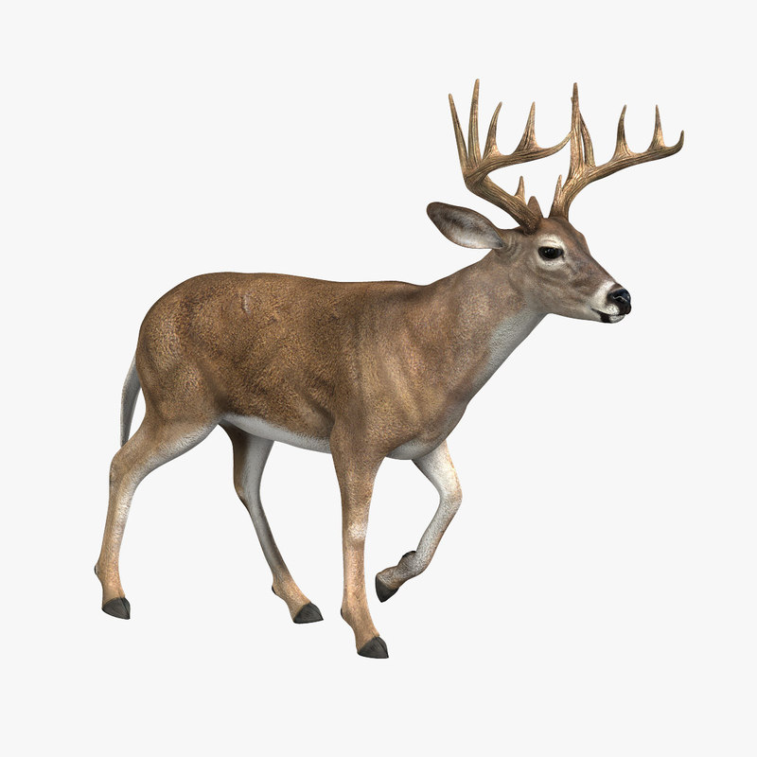
Data are collected on the length of the left hind leg and left foreleg for 10 deer.
Deer | Hind leg length (cm) | Foreleg length (cm) | Difference
1 | 142 | 138 | +
2 | 140 | 136 | +
3 | 144 | 147 | -
4 | 144 | 139 | +
5 | 142 | 143 | -
6 | 146 | 141 | +
7 | 149 | 143 | +
8 | 150 | 145 | +
9 | 142 | 136 | +
10 | 148 | 146 | +
Test the null hypothesis is that there is no difference between the hind leg and foreleg length in deer. Execute it with sign test.

Slide 29
There are n=10 deer. There are 8 positive differences and 2 negative differences. If the null hypothesis is true, that there is no difference in hind leg and foreleg lengths, then the expected number of positive differences is 5 out of 10. What is the probability that the observed result of 8 positive differences, or a more extreme result, would occur if there is no difference in leg lengths?
Because the test is two-sided, a result as extreme or more extreme than 8 positive differences includes the results of 8, 9, or 10 positive differences, and the results of 0, 1, or 2 positive differences. The probability of 8 or more positives among 10 deer or 2 or fewer positives among 10 deer is the same as the probability of 8 or more heads or 2 or fewer heads in 10 flips of a fair coin. The probabilities can be calculated using the binomial test, with the probability of heads = probability of tails = 0.5.

Slide 30
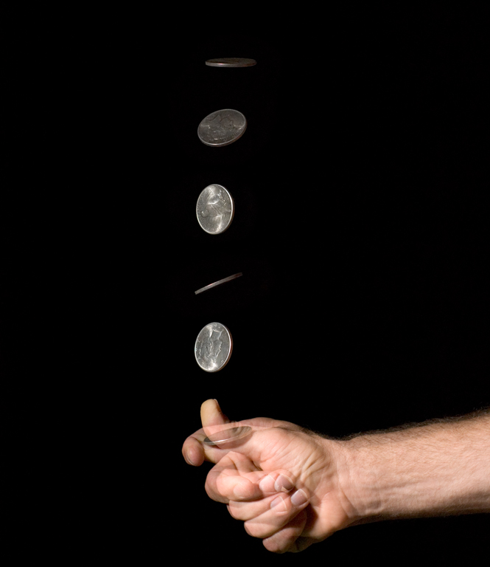
Probability of 0 heads in 10 flips of fair coin = 0.00098
Probability of 1 heads in 10 flips of fair coin = 0.00977
Probability of 2 heads in 10 flips of fair coin = 0.04395
Probability of 8 heads in 10 flips of fair coin = 0.04395
Probability of 9 heads in 10 flips of fair coin = 0.00977
Probability of 10 heads in 10 flips of fair coin = 0.00098
The two-sided probability of a result as extreme as 8 of 10 positive difference is the sum of these probabilities:
0.00098 + 0.00977 + 0.04395 + 0.04395 + 0.00977 + 0.00098 = 0.109375.
Thus, the probability of observing a results as extreme as 8 of 10 positive differences in leg lengths, if there is no difference in leg lengths, is p = 0.109375. The null hypothesis is not rejected at a significance level of p = 0.05. With a larger sample size, the evidence might be sufficient to reject the null hypothesis.

Slide 31

On the Late Show With David Letterman, the host (David) and the show’s musical director (Paul Shaffer) frequently assess whether particular items will or will not float when placed in a tank of water. Let’s assume Letterman guessed correctly for eight of nine items, and Shaffer guessed correctly for only four items. Let’s also assume all the items have the same probability of being guessed. Let's decide with Fisher's exact test about the null hypothesis that the guessing is independent of the person who has the bet, that is no significant difference between the guessing efficiencies.

Slide 32
Chi square test
You would typically use chi square the test when presented with the contingency table results in Figure 1. In this case, the chi squares test assesses what the expected frequencies would be if the null hypothesis (equal proportions) was true. For example, if there were no difference between Letterman and Shaffer’s guesses, you would expect Letterman to have been correct six times (see Figure 2). This is calculated as (9 * 12) / 18 = 108 / 18 = 6.
The resulting p-value, 0.046, from the chi square test indicates there is a statistically significant difference (at the α = 0.05 level) in the success rates between Letterman and Shaffer.

Slide 33
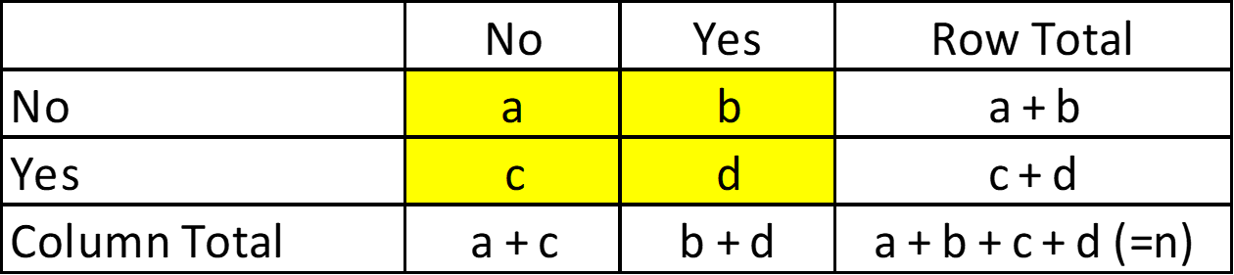
Fisher exact test
Fisher showed that the probability of obtaining any such set of values was given by the hypergeometric distribution:

Slide 34
Fisher exact test
Calculations for Fisher’s Exact Test
The hypergeometric probability distribution is used to compute the probability of the observed results (see Table 1).
The remaining tables that will be consistent with the marginal frequencies of 9, 9 and 12, 6, along with their associated probabilities, are shown in Table 2.

Slide 35
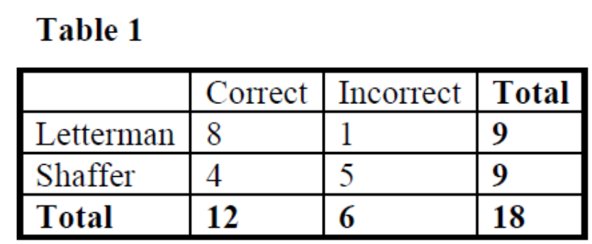
The probability of the observed results is:

Slide 36
Fisher exact test
To compute Fisher’s exact test results, look at the tables with probabilities less than or equal to the probability of the observed results (0.061085972). They are highlighted with an *. Add these probabilities together, along with the probability of the observed results, to obtain the p-value for the test.
This particular p-value is 0.131221720, that is we accept the null hypothesis.

