Slide 1
Multivariate Linear Regression
PhD Course

Slide 2
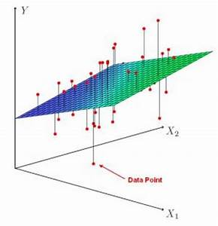
Multivariate linear regression

Slide 3


Slide 16
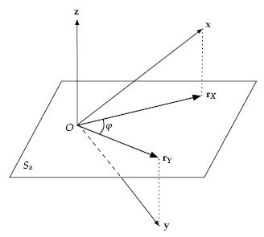
Geometrical interpretation of the partial correletion between x and y.
The effect coused by z is eliminated at this correlation value between x and y.

Slide 17
Partial F test

Slide 18
Partial F test

Slide 19
Partial F test

Slide 20
Partial F test

Slide 21
Automated modeling algorithms

Slide 22
Automated modeling algorithms

Slide 23
Automated modeling algorithms

Slide 24
Adjusted Coefficient of Determination
You can use the adjusted coefficient of determination to determine how well
a multiple regression equation fits the sample data. The adjusted coefficient of
determination is closely related to the coefficient of determination (also known
as R²) that you use to test the results of a simple regression equation.
p the number of the explanatory variables in the model

Slide 25
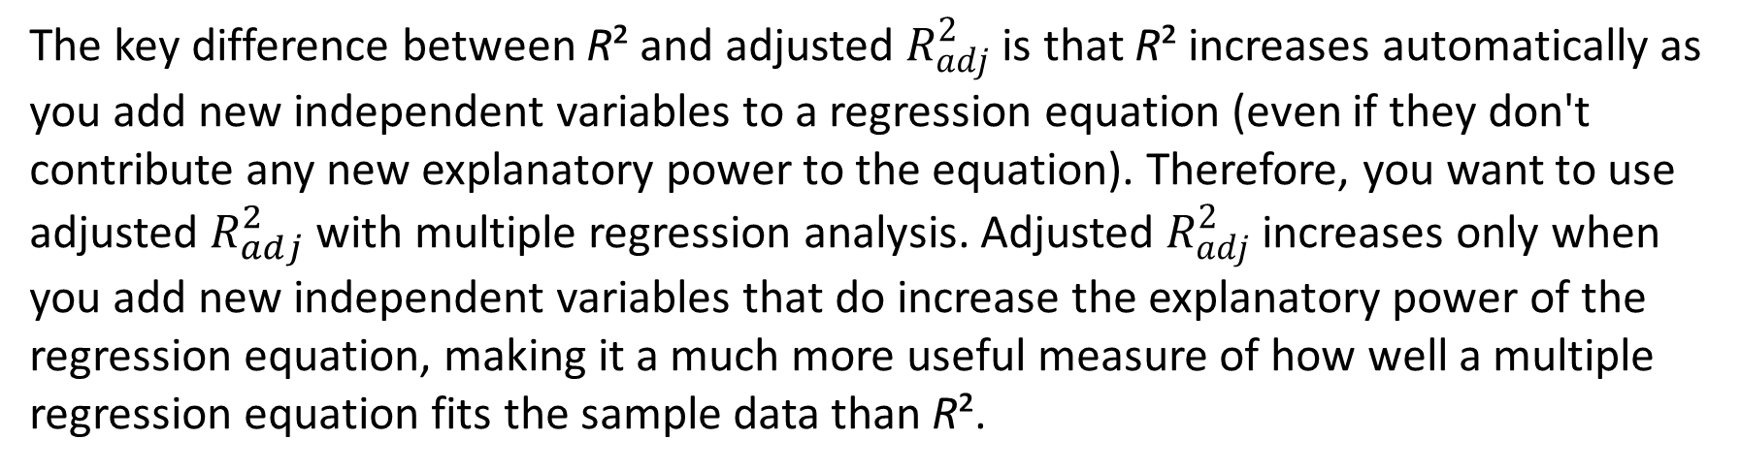
Adjusted Coefficient of Determination
The key difference between R² and adjusted $R_{adj}^{2}$ is that R² increases automatically as you add new independent variables to a regression equation (even if they don't contribute any new explanatory power to the equation). Therefore, you want to use adjusted $R_{adj}^{2}$ with multiple regression analysis. Adjusted $R_{adj}^{2}$ increases only when you add new independent variables that do increase the explanatory power of the regression equation, making it a much more useful measure of how well a multiple regression equation fits the sample data than R².

Slide 27
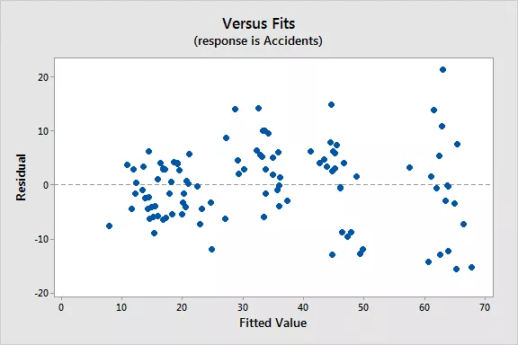
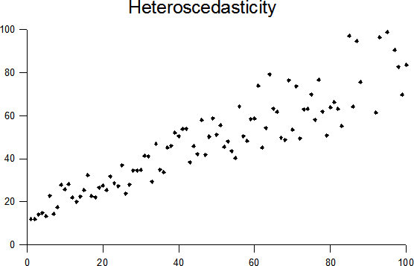
Heteroscedasticity in Regression Analysis
You can see an example of this cone shaped pattern in the residuals by fitted value plot below. Note how the vertical range of the residuals increases as the fitted values increases.

Slide 29
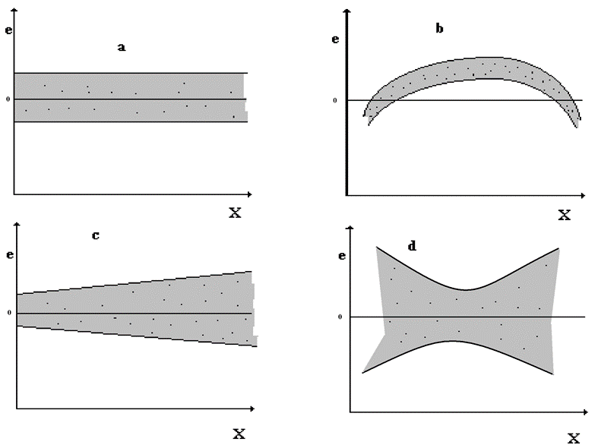
Heteroscedasticity in Regression Analysis
Possible types of scattering of residuals at zero level
a.) the scatter corresponds to the linear model,
b.) not the linear model belong to the residuals,
c.) the scatterings are not the same,
d.) the errors are not independent of each other.

Slide 30
Heteroscedasticity in Regression Analysis
Heteroscedasticity means unequal scatter. In regression analysis, we talk about heteroscedasticity in the context of the residuals or error term. Specifically, heteroscedasticity is a systematic change in the spread of the residuals over the range of measured values. Heteroscedasticity is a problem because ordinary least squares (OLS) regression assumes that all residuals are drawn from a population that has a constant variance (homoscedasticity).
To satisfy the regression assumptions and be able to trust the results, the residuals should have a constant variance.

Slide 31
Types of Residual
When calculating the linear estimate, we do not calculate the "i" case, we "delete" it.
Common Residual:
Deleted Residual:
Standardized Residual:
Studendized Residual:

Slide 35
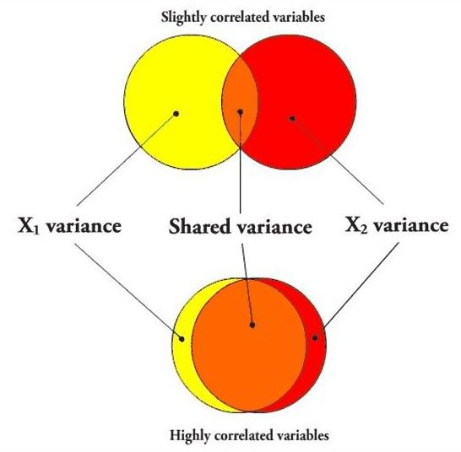
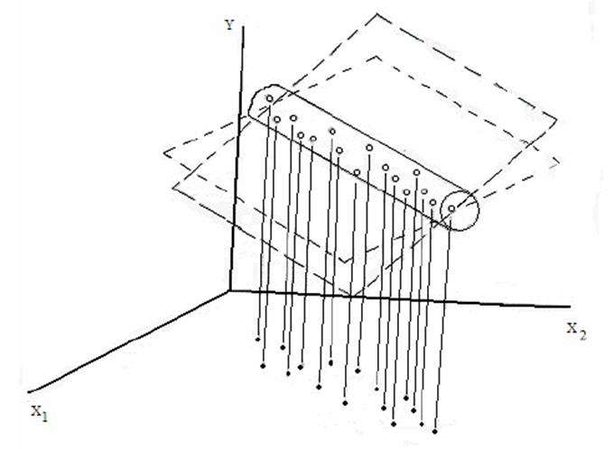
In the case of multicollinearity
• the effect of the explanatory variables on the dependent variables can not be separated,
• the explanatory variables can assume each other's role,
• the estimation of regression coefficients becomes unreliable,
• In extreme cases, analysis can not be performed.

Slide 36
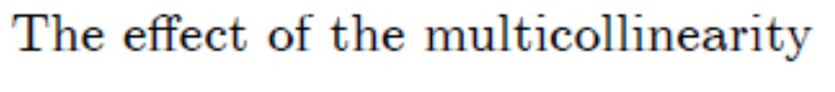

Slide 38
Geometrical interpretation of the multiple correlation coefficient.
The multiple correlation between the u vector and the pair (x, y) is
the cosine of β. This is the angle between u and its projection vector
Onto plane spanned by x and y vectors.

Slide 41
Exploring of the points which effect significantly to the regression
An important step in the evaluation of the linear regression model is the exploration of the importance of individual data points.
What are the data points that show the ultimate connection most strongly, and what are the so-called outlier points that are least suited to the particular regression context.

Slide 42
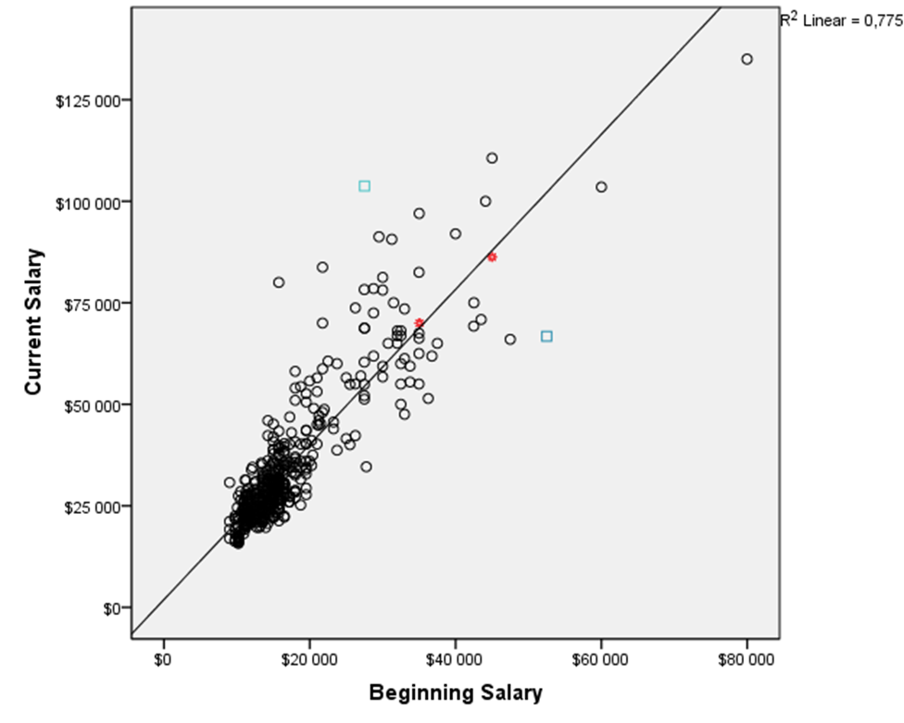
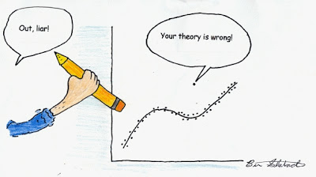
Exploring of the points which effect significantly to the regression

Slide 43
Exploring of the points which effect significantly to the regression
Connection between the target variable Y and it's linear estimate:
Estimated error vector, residual amount, regression amount:

Slide 44
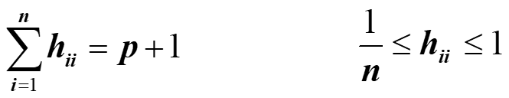
Exploring of the points which effect significantly to the regression
the leverage matrix
The h_{ii} diagonal element of the matrix indicates the quantity of the influence of the i-th data point onto the regression estimation.
where
the ith data point

Slide 45
Exploring of the points which effect significantly to the regression
The influence of case i is average if
They are the typical points
The influence of case i is significant if
Case i can be included in the analysis if
It is risky to involve the case i if
Case i must be omitted from the analysis because it is "outlier"

Slide 46
EXAMPLE
What and how does it affect life expectancy?
Using a data file containing countries, we look for contact between the life expectancy of male and certain economic / social status variables.
The dependent variable Y is now the lifeexpm, ie the life expectancy of male
The explanatory variables:
population density, degree of urbanization, calorie uptake, GDP, yield, child mortality, readership level, birth rate, death rate, population growth, number of children per family.

Slide 47
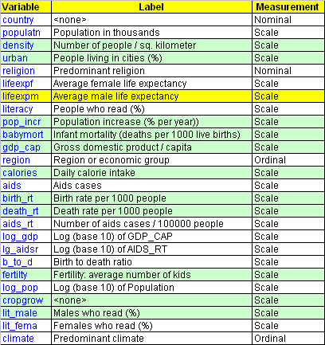
Y

Slide 48
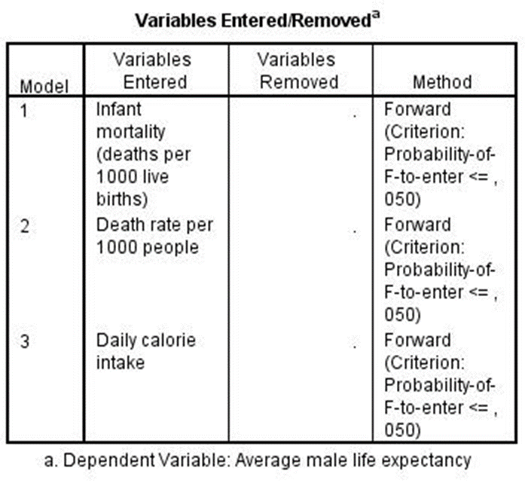
The automated modeling setup was FORWARD, which takes new variables from the list of variables until it can fix it. It has taken three variables in final: infant mortality, death rate, daily calorie intake.

Slide 49
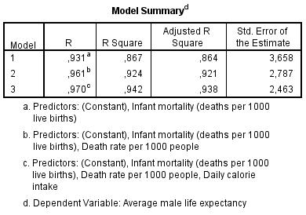
With the help of the three variables, a 97% explanatory power could be achieved.

Slide 50
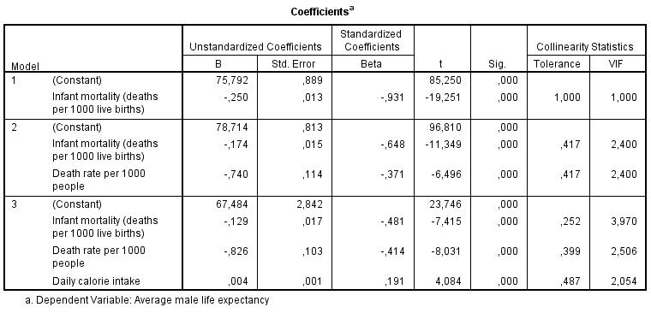
The first two variables have negative, the calorie has positive coefficient.

Slide 51
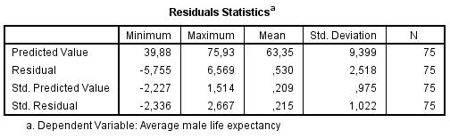
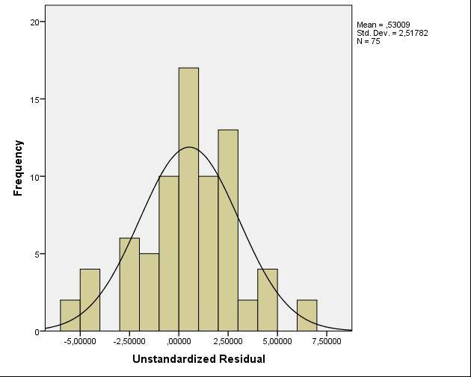
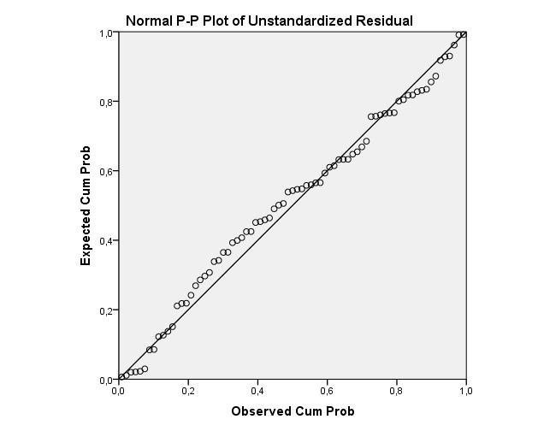
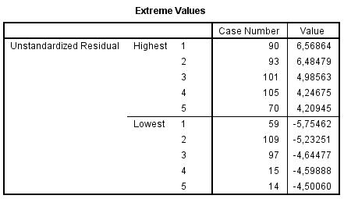

Slide 52
Binary logistic regression

Slide 53
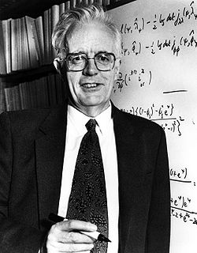
Binary logistic regression

Slide 54
Binary logistic regression

Slide 55
Binary logistic regression

Slide 56
Binary logistic regression

Slide 57


Slide 65


