Slide 1
Limits of Functions

Slide 2
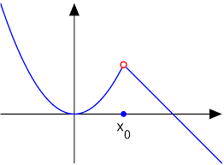
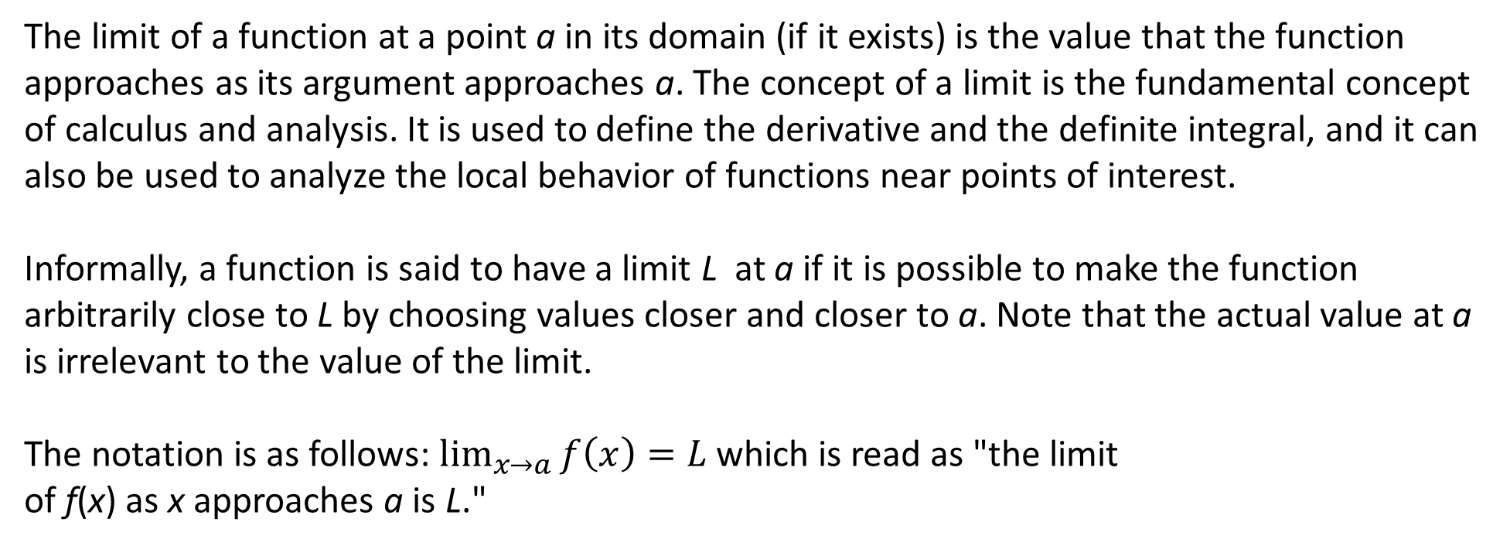
The limit of a function at a point a in its domain (if it exists) is the value that the function approaches as its argument approaches a. The concept of a limit is the fundamental concept of calculus and analysis. It is used to define the derivative and the definite integral, and it can also be used to analyze the local behavior of functions near points of interest.
Informally, a function is said to have a limit L at a if it is possible to make the function arbitrarily close to L by choosing values closer and closer to a. Note that the actual value at a is irrelevant to the value of the limit.
The notation is as follows: $\lim_{x→a}{f\left(x\right)=L }$which is read as "the limit of f(x) as x approaches a is L."
The limit of f(x) at $x_{0}$​ is the y-coordinate of the red point, not the substitute value f($x_{0}$​).

Slide 3
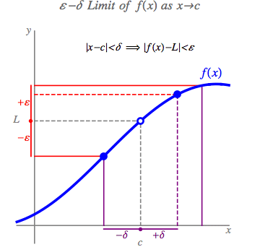

Slide 4
Properties of Limits

Slide 5
One-sided Limits

Slide 8
Infinite Limits

Slide 10
Limits at Infinity

Slide 11

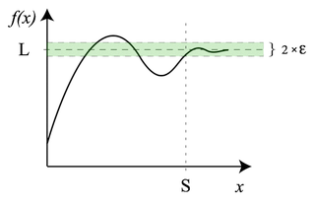

Slide 12
All possible limit problems
$$\lim_{x→a}{f\left(x\right)=L, }\lim_{x→a+0}{f\left(x\right)=L,\lim_{x→a−0}{f\left(x\right)=L }}$$
$$\lim_{x→a}{f\left(x\right)=∞, }\lim_{x→a+0}{f\left(x\right)=∞,\lim_{x→a−0}{f\left(x\right)=∞ }}$$
$$\lim_{x→a}{f\left(x\right)=−∞, }\lim_{x→a+0}{f\left(x\right)=−∞,\lim_{x→a−0}{f\left(x\right)=−∞ }}$$
$$\lim_{x→a}{f\left(x\right)=d.n.e., }\lim_{x→a+0}{f\left(x\right)=d.n.e.,\lim_{x→a−0}{f\left(x\right)=d.n.e. }}$$
$$\lim_{x→∞}{f\left(x\right)=L, }\lim_{x→∞}{f\left(x\right)=∞,\lim_{x→∞}{f\left(x\right)=−∞,\lim_{x→∞}{f\left(x\right)=d.n.e. }}}$$
$$\lim_{x→−∞}{f\left(x\right)=L, }\lim_{x→−∞}{f\left(x\right)=∞,\lim_{x→−∞}{f\left(x\right)=−∞,\lim_{x→−∞}{f\left(x\right)=d.n.e. }}}$$

Slide 13
Addition with infinite
$$\lim{f\left(x\right)}=L,\lim{g\left(x\right)}=M then the result of the\lim\left(f\left(x\right)+g\left(x\right)\right) problem:$$

Slide 14
Subraction with infinite
$$\lim{f\left(x\right)}=L,\lim{g\left(x\right)}=M then the result of the\lim\left(f\left(x\right)−g\left(x\right)\right) problem:$$

Slide 15
Production with infinite
$$\lim{f\left(x\right)}=L,\lim{g\left(x\right)}=M then the result of the\lim\left(f\left(x\right)∙g\left(x\right)\right) problem:$$

Slide 16
Division with infinite
$$\lim{f\left(x\right)}=L,\lim{g\left(x\right)}=M then the result of the\lim\left(f\left(x\right)/g\left(x\right)\right) problem:$$

Slide 17
Sandwich Theorem

Slide 18
Show that:
The maximum value of sine is 1, so
The minimum value of sine is -1, so
So:
By the sandwich theorem:

Slide 19
Using the Sandwich theorem to find $\lim_{x→0}{\frac{sinx}{x}}$
If we graph , it appears that

Slide 20
If we graph , it appears that
We might try to prove this using the sandwich theorem as follows:
Unfortunately, neither of these new limits are defined, since the left and right hand limits do not match.
Unfortunately, neither of these new limits are defined, since the left and right hand limits do not match.
We will have to be more creative. Just see if you can follow this proof. Don’t worry that you wouldn’t have thought of it.

Slide 21
Note: The following proof assumes positive values of .
You could do a similar proof for negative values.
P(x,y)
1
(1,0)
Unit Circle

Slide 22
T
P(x,y)
1
O
A
(1,0)
Unit Circle

Slide 23
T
P(x,y)
1
O
A
(1,0)
Unit Circle

Slide 24
T
P(x,y)
1
O
A
(1,0)
Unit Circle

Slide 25
T
P(x,y)
1
O
A
(1,0)
Unit Circle

Slide 26
T
P(x,y)
1
O
A
(1,0)
Unit Circle

Slide 27
T
P(x,y)
1
O
A
(1,0)
Unit Circle

Slide 28
T
P(x,y)
1
O
A
(1,0)
Unit Circle

Slide 29
T
P(x,y)
1
O
A
(1,0)
Unit Circle

Slide 30
multiply by two
divide by
Take the reciprocals, which reverses the inequalities.
Switch ends.

Slide 31
By the sandwich theorem:

Slide 32
Using the definition of the limit proof the next three statements:

Slide 34
Using the definition of the limit proof the next statement:

Slide 35
The definitions in this case:
So

Slide 36
Using the definition of the limit proof the next five statements:

Slide 37
Solution:

Slide 38
Solution:

Slide 39
Solution:

Slide 40
Solution:

Slide 41
HOMEWORKS:

Slide 42
Solution:

Slide 43
Solution:

Slide 44
Solution:

Slide 45
HOMEWORK

