Slide 1
Factor Analysis
PhD Course

Slide 2
Factor Analysis - Introduction
Factor analysis is used to draw inferences on unobservable quantities such as intelligence, musical ability, patriotism, consumer attitudes, that cannot be measured directly.
The goal of factor analysis is to describe correlations between p measured traits in terms of variation in few underlying and unobservable factors.
Changes across subjects in the value of one or more unobserved factors could affect the values of an entire subset of measured traits and cause them to be highly correlated.

Slide 3
Factor Analysis - Introduction
Good factor analysis can be expected if there is a strong correlation between variables involved in the study. At this point, there is a chance that the common information space should be spanned by a small number of uncorrelated variables (they will be the common factors).
The variables that are poorly correlated with other variables should be omitted from factor analysis.

Slide 4
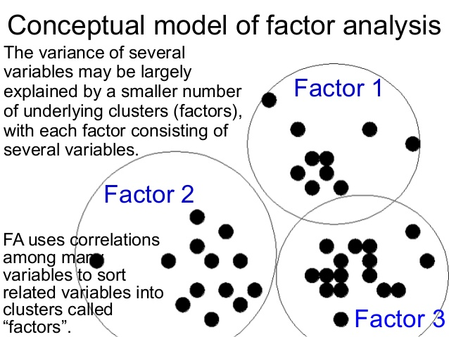

Slide 5
Factor Analysis - Example
A marketing firm wishes to determine how consumers choose to patronize certain stores.
Customers at various stores were asked to complete a survey with about p = 80 questions.
Marketing researchers postulate that consumer choices are based on a few underlying factors such as: friendliness of personnel, level of customer service, store atmosphere, product assortment, product quality and general price level.
A factor analysis would use correlations among responses to the 80 questions to determine if they can be grouped into six sub-groups that reflect variation in the six postulated factors.

Slide 6

Factor Analysis
The k-Factor Model
The vector of the observed variables are
Suppose that

Slide 7
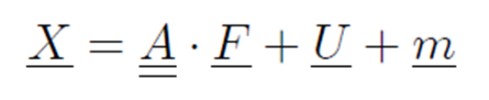
Factor Analysis
where

Slide 8
Factor Analysis
Calculating the expectations of the sides

Slide 9
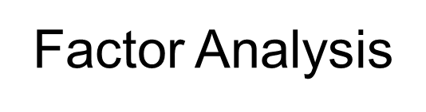

Slide 10
unique factor
common factors

Slide 12

The portion of the variance that is contributed by the k common factors is the communality and the portion that is not explained by the common factors is called the uniqueness (or the specific variance).

Slide 13
covariance

Slide 14
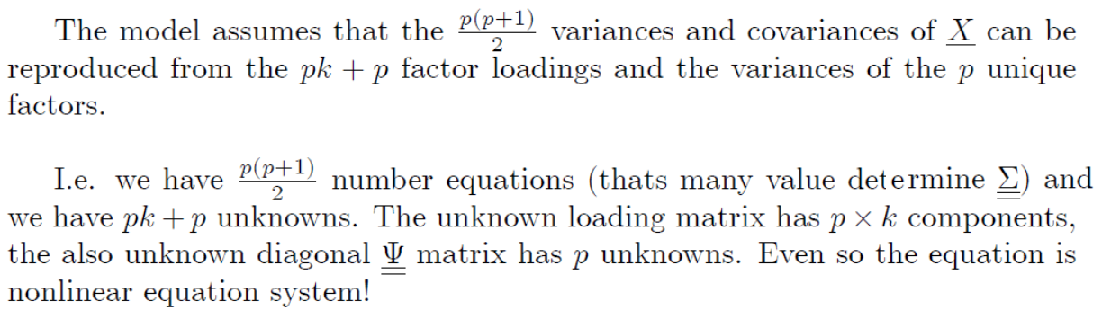

Slide 19
The process of the factor analysis
v₁……...v_{k}
v₁……...v_{k}
F₁…..F_{j}
v₁
.
.
.
v_{k}
O₁
.
.
.
.
.
.
.
.
O_{n}
v₁
.
.
.
v_{k}
Covariance matrix
Loading matrix
Data matrix

Slide 21
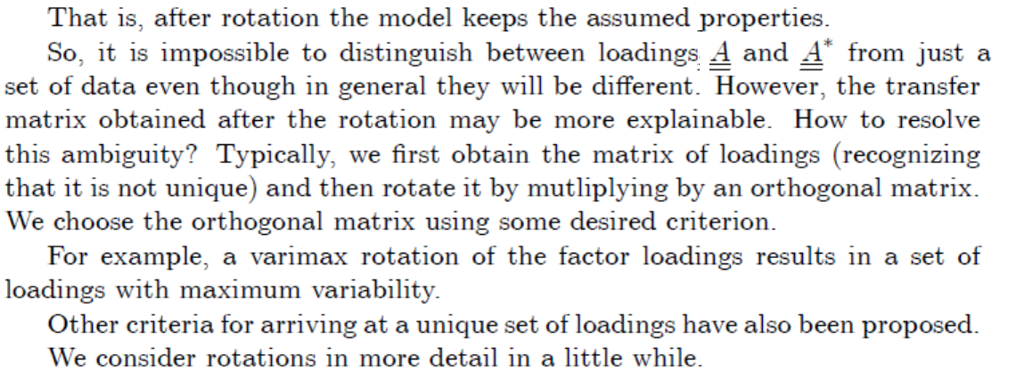

Slide 22
Illustrating rotation in a simple two-dimensional example:
1
0 1
The original variables belonging the set a and b have a significant factor weight on both factors without rotation.
a
b
-1 0 +1

Slide 23
Illustrating rotation in a simple two-dimensional example:
After rotation the variables lying in the group 'a' has weight near zero at the first factor and the variables lying in the group 'b' has weight near zero at the other factor.
1
0 -1
a
b
-1 0 +1

Slide 24
An orthogonal rotation method that minimizes the number of variables that have high loadings on each factor. This method simplifies the interpretation of the factors
The rotations which make the model be more meaningful:
A method for oblique (nonorthogonal) rotation. When delta equals 0 (the default), solutions are most oblique. As delta becomes more negative, the factors become less oblique. To override the default delta of 0, we can enter a number less than or equal to 0.8.
Varimax
Quartimax
A rotation method that minimizes the number of factors needed to explain each variable. This method simplifies the interpretation of the observed variables.
Equamax
Direct Oblimin
Promax Rotation
A mixed rotation method that is a combination of the varimax method, which simplifies the factors, and the quartimax method, which simplifies the variables. The number of variables that load highly on a factor and the number of factors needed to explain a variable are minimized.
An oblique rotation, which allows factors to be correlated. This rotation can be calculated more quickly than a direct oblimin rotation, so it is useful for large datasets.

Slide 25
VARIMAX rotation

Slide 26
VARIMAX rotation
where
the creating loading matrix
the ith cummunality

Slide 27
VARIMAX rotation

Slide 28
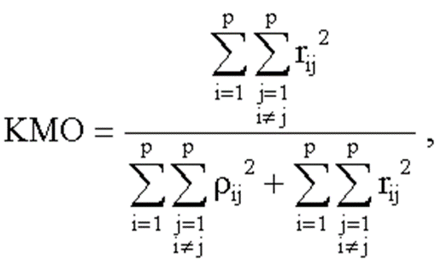


Kaiser-Meyer-Olkin (KMO) Test for Sampling Adequacy
There is only a chance for a good factor analysis if there is a strong correlation between the variables included in the study. The relationship is tested by the KMO statistics:
where
The partial correlation coefficients
The Pearson correlation

Slide 29
Kaiser-Meyer-Olkin (KMO) Test for Sampling Adequacy
Kaiser-Meyer-Olkin (KMO) Test is a measure of how suited your data is for Factor Analysis. The test measures sampling adequacy for each variable in the model and for the complete model.
For reference, Kaiser put the following values on the results:
0.00 to 0.49 unacceptable.
0.50 to 0.59 miserable.
0.60 to 0.69 mediocre.
0.70 to 0.79 middling.
0.80 to 0.89 meritorious.
0.90 to 1.00 marvelous.

Slide 30
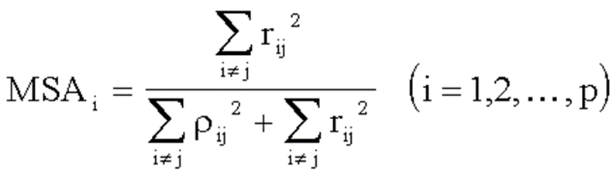
Measure of Sampling Adequacy
If the KMO statistic is not large enough, some variables for which MSA statistics are small are omitted. With this residual variables, the value of KMO statistic increases.
From the start p variable, you should leave the ones having small MSA_{i} value.

Slide 31
Bartlett’s Test of Sphericity
Before being able to run the factor analysis, one should ensure that the data has an adequate level of multicolinearity, the multicolinearity issue is not desirable in regression analysis but it is a prerequisite here. Bartlett's measure tests the null hypothesis that the original correlation matrix is an identity matrix.
H₀: The Correlation Matrix= E (Identity Matrix)
H₁: The Correlation Matrix≠ E (Identity Matrix)
The E identity matrix is the matrix in which all the diagonal elements are ones and the off diagonal elements are zeros. Meaning that there original data has no correlations among its variables.
Factor analysis cannot be performed on the data for which the correlation matrix is the identity matrix. Therefore, we want this test to be significant (i.e. has a significance value less than 0.05). If the P value is less than 0.05 we have to reject the null hypothesis thus there are some relationships between the variables we considered in the analysis.

Slide 32
Principal Component Analysis (PCA)
A special case of the factor analysis. This method leads to radical dimension reduction. Instead of the originally used p variables we will express the statistical population wih k transformed variables, where k<<p.
The conclusions of the k-dimensional statistical analyzes will also apply to the p-dimensional population. This can save you considerable costs. It is possible to illustrate the p> 3 dimensional population (if k <4) on the scatter dot graph.
Furthermore, the variables in the new space will be uncorralated.

Slide 33
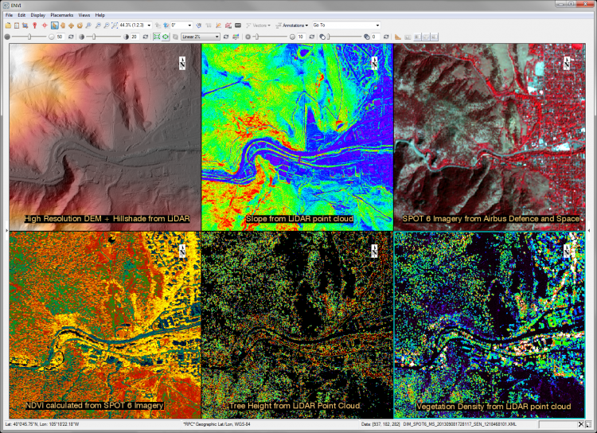
An example
At the processing multispectral digital satellite images a problem arises at displaying visual content. If the number of spectrums is more than three, then three must be selected for the R, G, B channels to make a composite image on the display. Choosing any three ones of the existing spectrums will result in significant visual loss. However, if you select the first three principal components for display, we get a much better solution.

Slide 34

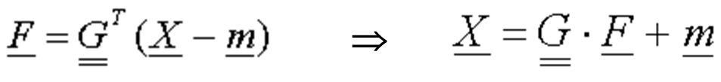

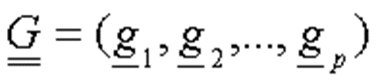
The principal component transformation is:
(A special factor model)
vector of the principal components
matrix of the principal direction vectors

Slide 35

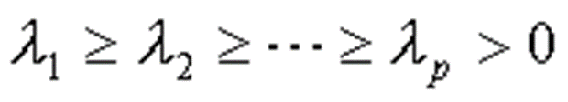
The principal components are uncorralated:
The importance of the principal components decreases:
Shows how many percents F_{i} is being explained from the total variation

Slide 36
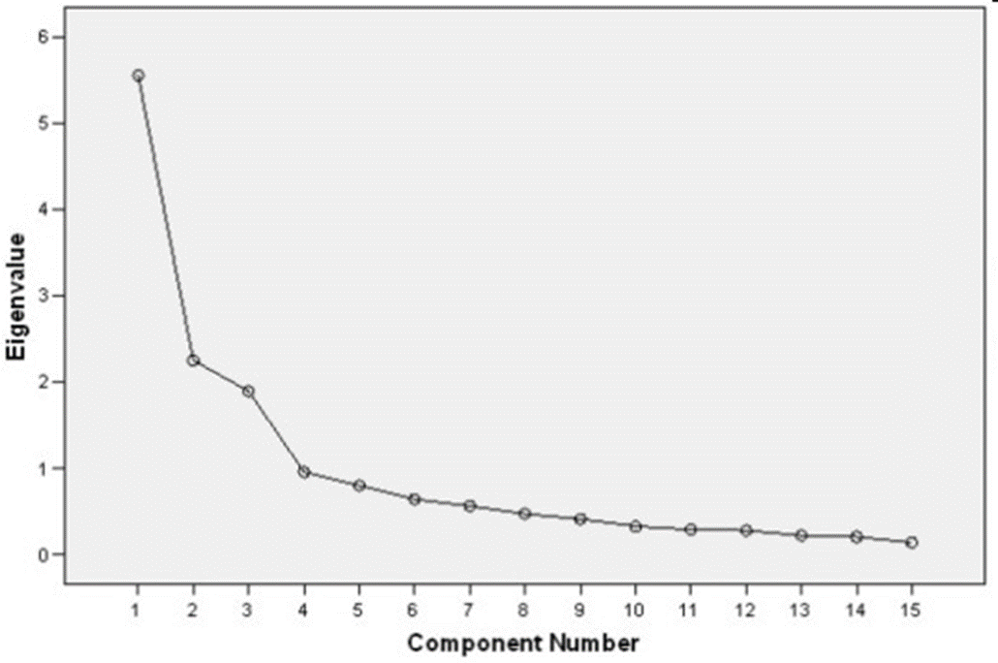
The Scree Plot
The number of main components should be given there where the scree plot begins to be "flat".

Slide 37
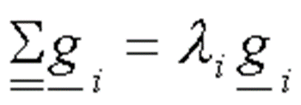


Meaning of the principal directions
where
is the eigenvector of the covariance matrix to the largest eigenvalue
it carries the most information
is the e.v. of the c. m. to the second largest eigenvalue
It carries the most information in the directions whics orthogonal onto
.
.
.

Slide 38
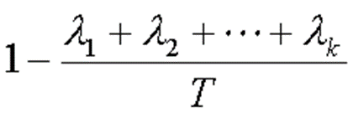
dimension reduction
If instead of the original p variables, only the first k principal factor-vector is counted the lost information is merely:

Slide 39
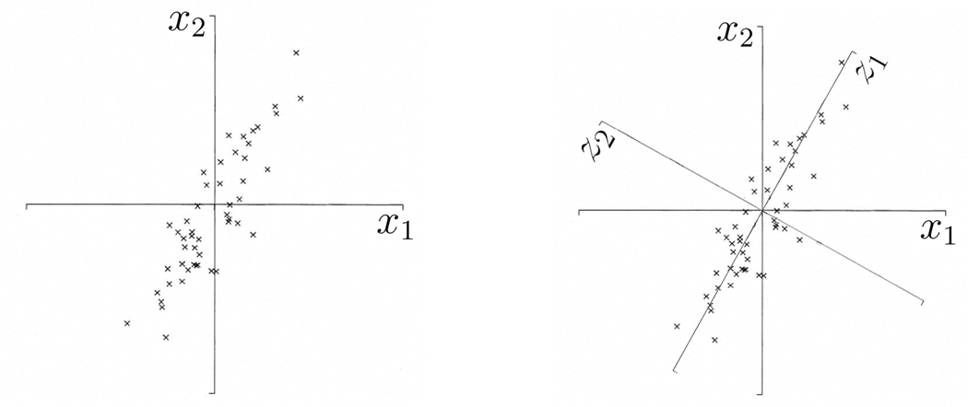
dimension reduction
The first principal component direction (z1) is the direction of the straight line in plane X around where the largest of the scattering of the points.
The second main component direction (z2) is perpendicular to z1.

Slide 40
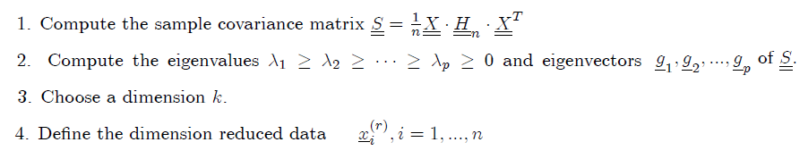

Slide 41
where

Slide 43
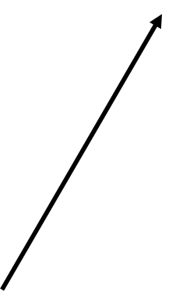

Illustration in 3D
Axes do not form square right angles: variables are correlated!
3. direction
1. direction
2. direction

Slide 44
Illustration in 3D
We seek the longest axis of the scatter dots ⇨ this is the first principal direction
In this direction, we can best differentiate between points. The length (importance) of the main components is characterized by eigenvalue, which is the interpreted variance.
3. direction
1. direction
2. direction

Slide 45
Illustration in 3D
The procedure could be continued by finding the third principal component, but in this particular case it makes no sense, because scattering is already insignificant in this direction so 2 dimensions are enough to describe the data!
Now we look for the longest axis perpendicular to the first principal direction ⇨
this is the second principal direction
3rd direction
1st direction
2nd direction

Slide 46
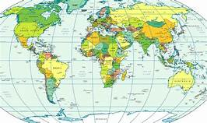
EXAMPLE 1
populatn Population in thousands
density Number of people / sq. kilometer
urban People living in cities (%)
lifeexpf Average female life expectancy
lifeexpm Average male life expectancy
literacy People who read (%)
pop_incr Population increase (% per year)
babymort Infant mortality (deaths per 1000 live births)
gdp_cap Gross domestic product / capital
calories Daily calorie intake
aids Aids cases
birth_rt Birth rate per 1000 people
death_rt Death rate per 1000 people
aids_rt Number of aids cases / 100000 people
b_to_d Birth to death ratio
fertilty Fertility: average number of kids
cropgrow crop growth rate
lit_male Males who read (%)
lit_fema Females who read (%)
World95.sav file contains data about 109 countries. We execute the factor analysis with the next 19 variables.

Slide 47
EXAMPLE 1
Let's examine the relationship between the variables of the world 95 file! In the last coloumn stand the MSA indicators of the variables.

Slide 48
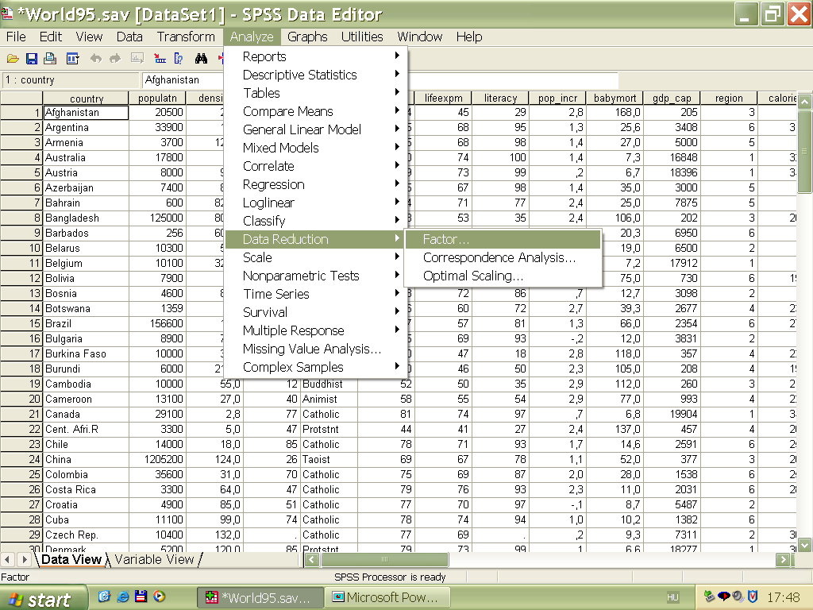
EXAMPLE 1

Slide 49
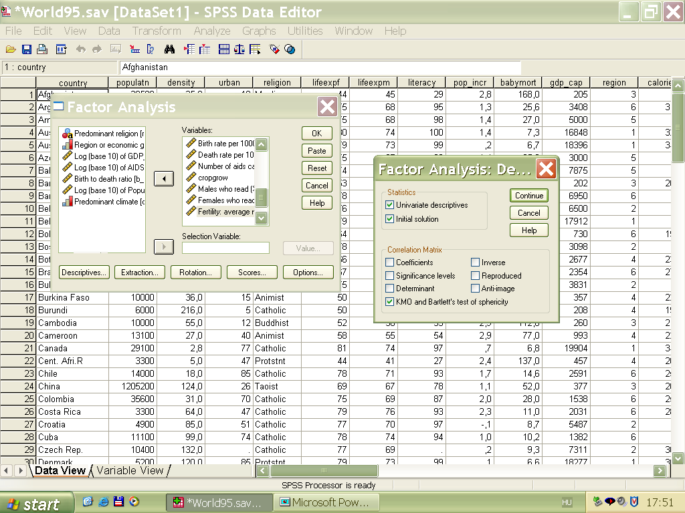
2018. 04. 15.
Dr Ketskeméty László előadása
49

Slide 50
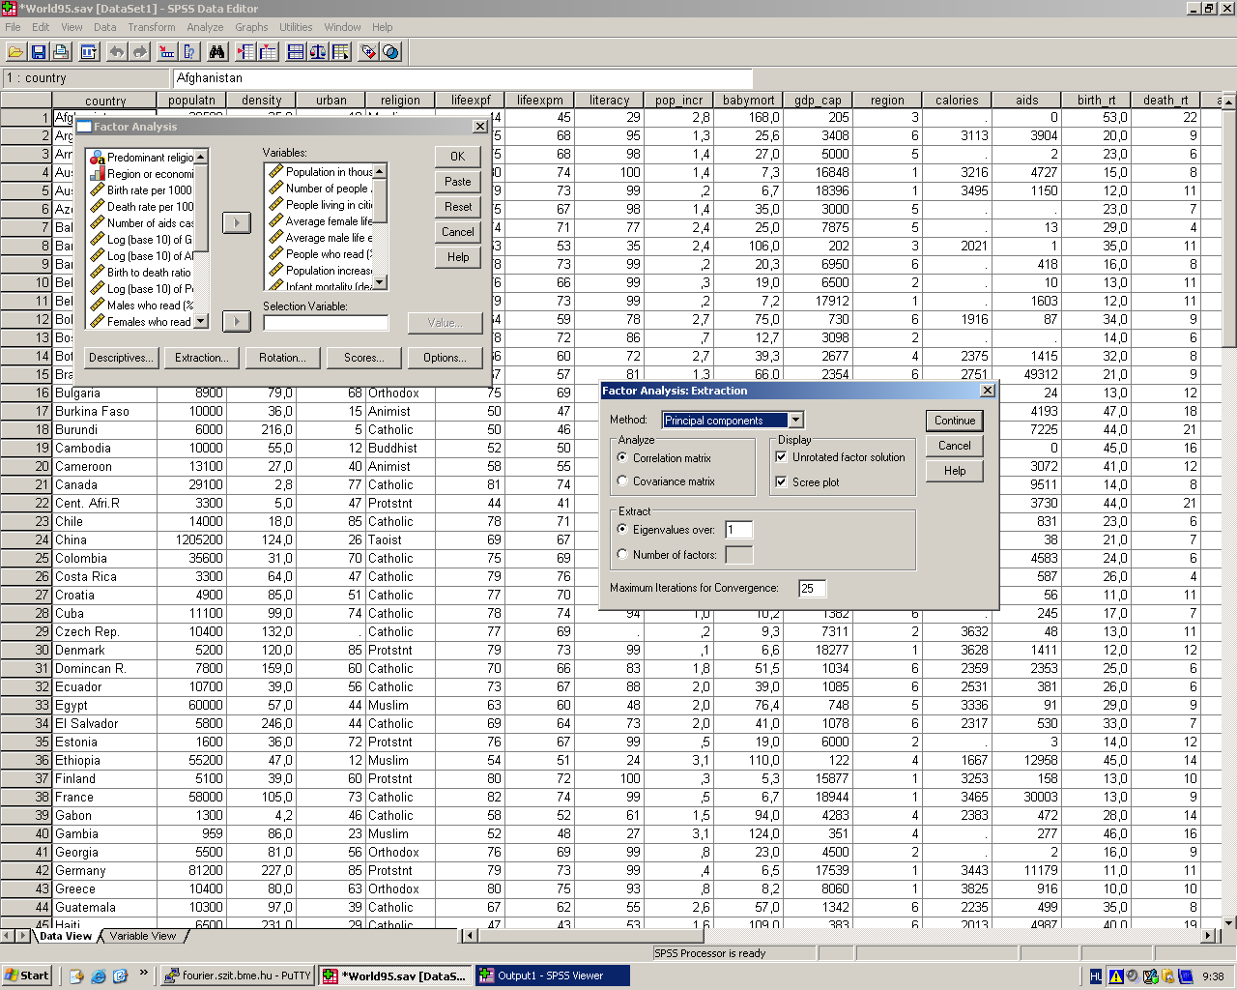

Slide 51
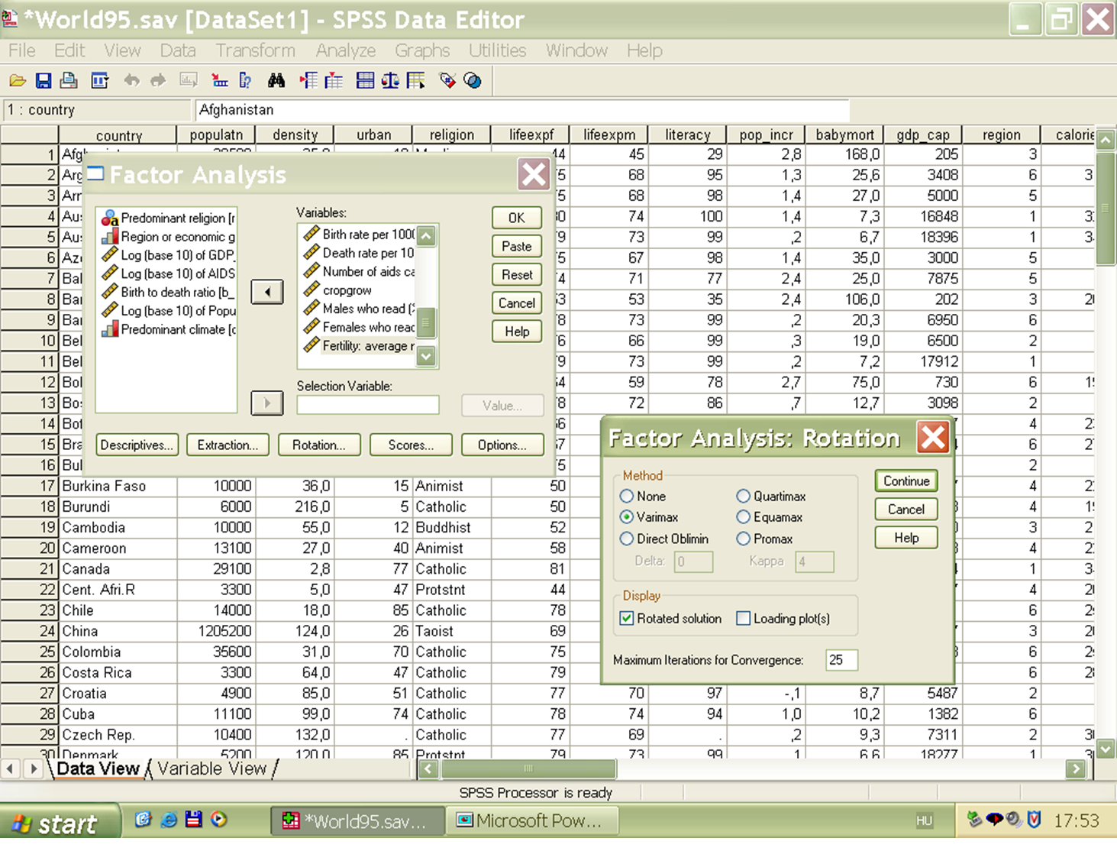

Slide 52
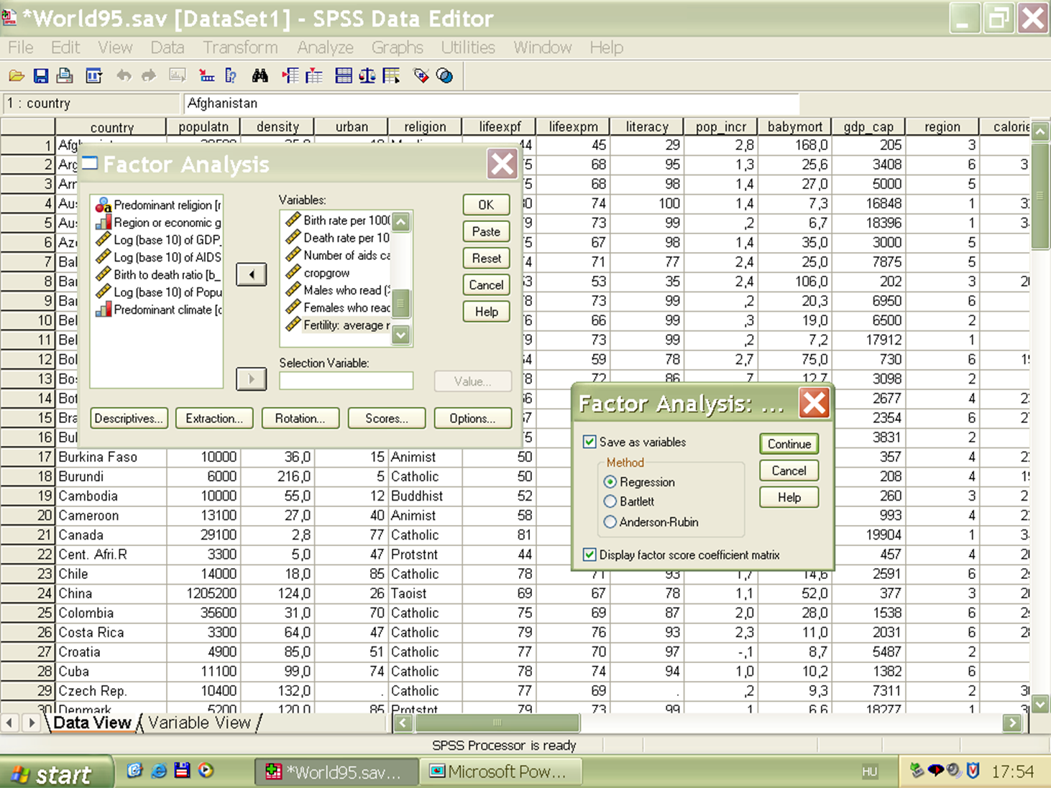

Slide 53
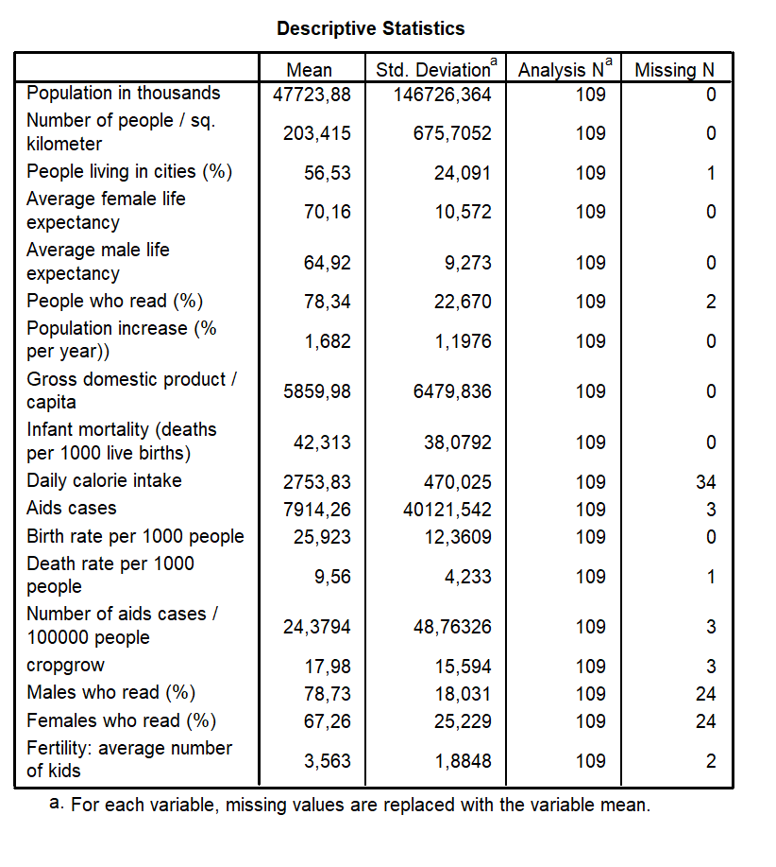

Slide 54
KMO „meritorious” !
A Bartlett-spherical test refuse the independency

Slide 55
One hundred times the value of communality shows how many percent of each variables can be "explained" by the common factors. The variables with small communality value are "point out" from the common information space. If we left out them, a better factor analysis can be provided for the remaining variables.

Slide 56
With four factors, explanation is almost 80%, ie 13 dimensions reduced into 4 and "only" 20% of the information was lost!

Slide 57
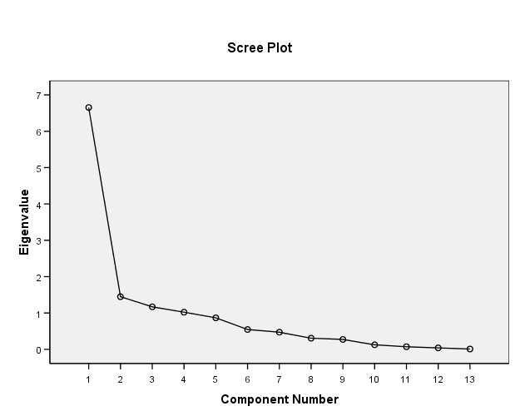
The decreasing of the importance of each principal components can see in the scree plot. In our case, the first four principal components were held..

Slide 58
This table shows the loading matrix. It can be seen how weights are involved in the production of each variables

Slide 59
After rotating, we get a better interpretable model. This helps us to understand the factors and to explore the relationship system of variables.
The loading matrix generated after the varimax rotation.

Slide 60
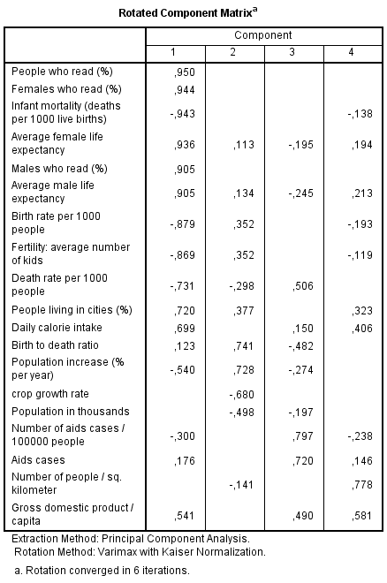
If we suppress the small values in the table, it becomes clearer. It is apparent that only the factor 1 is involved in the production of the first two variables. So factor 1 is related to the level of culture.

Slide 61

Factor 2 is related to yield, agricultural development.

Slide 62

Factor 3 can be related to the development of healthcare because it has a high value for variables such as number of aids cases, death rate.

Slide 63
Factor 4 is related to population densities.

Slide 64
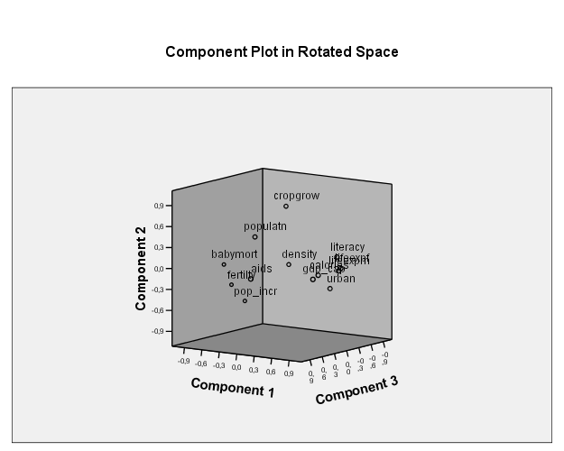
In the space spanned by the first three principal direction vectors we can illustrate the locations of the examined variables.
The orthogonal matrix of the rotation

Slide 65
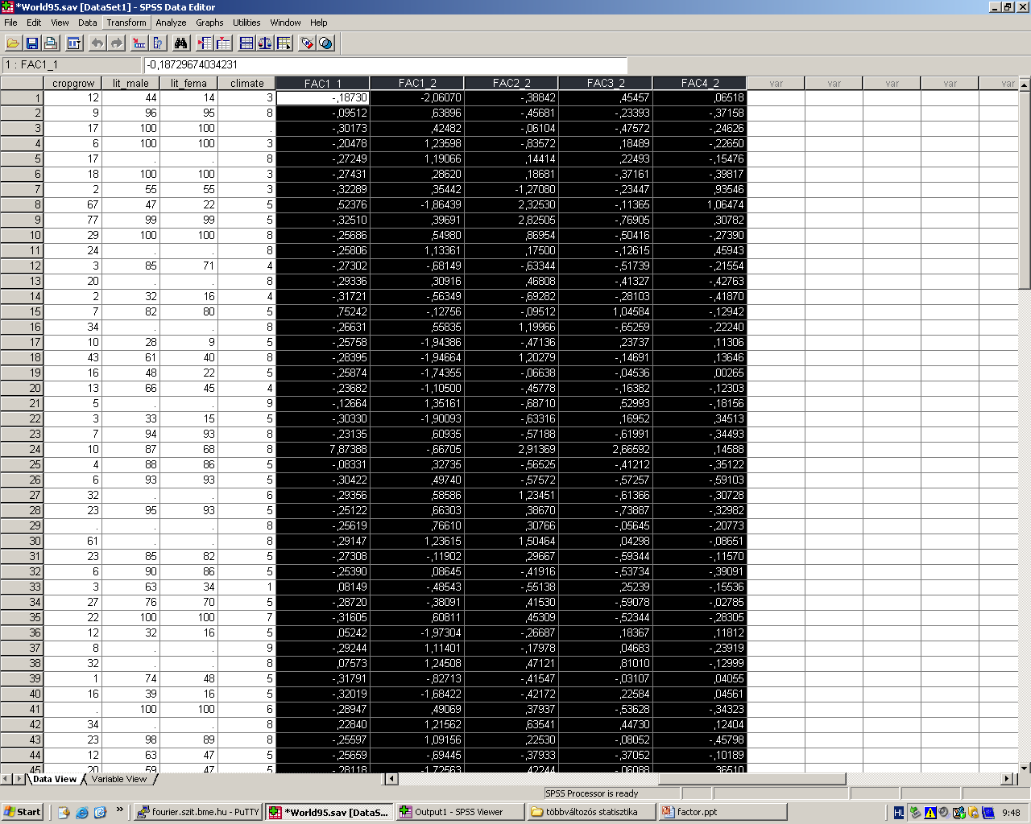
In the data matrix, the principal direction vectors were saved as new variables
2018. 04. 15.
Dr Ketskeméty László előadása
65

Slide 66
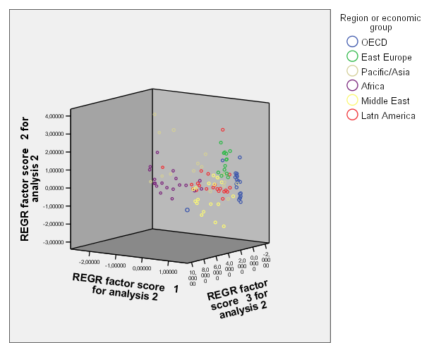
With the first three principal direction vector each country can also be depicted in Figures 3-D. The points were colorized according to the economic region. This also may help in the interpretation of factors.

