Slide 1
Application of Differentation

Slide 2
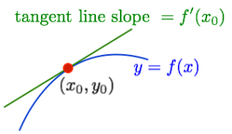
Equation of the tangent line to the graph of the function
The equation of the line passing through the point $\left(x_{0},y_{0}\right)$ and having slope $m=f^{′}\left(x_{0}\right) is$
$$y=f^{′}\left(x_{0}\right)\left(x−x_{0}\right)+y_{0}=f^{′}\left(x_{0}\right)\left(x−x_{0}\right)+f\left(x_{0}\right)$$

Slide 4


$$⇒$$
$$⇒$$

Slide 5
EXERCISES

Slide 6
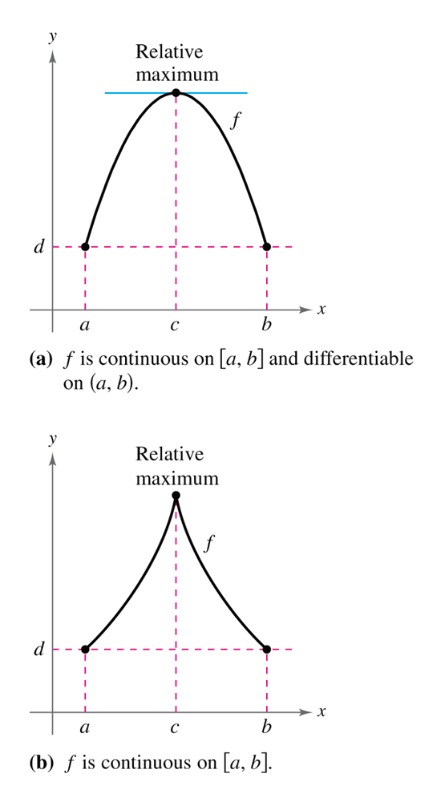
Rolle’s Theorem
Rolle's theorem is an important basic result about differentiable functions. Like many basic results in the calculus it seems very obvious. It just says that between any two points where the graph of the differentiable function f (x) cuts the horizontal line there must be a point where f '(x) = 0. The following picture illustrates the theorem.

Slide 7
Rolle’s Theorem
If 1) f (x) is continuous on [a, b],
2) f (x) is differentiable on (a, b), and
3) f (a) = f (b)
then there is at least one value of x on (a, b), call it c, such that
f ’(c) = 0.
f is continuous on [a, b]
differentiable on (a, b)
f(a) = f(b)
a
b

Slide 8
Example
Example 1
( f is continuous and differentiable)
Since , then Rolle’s Theorem applies…
then, x = –1 , x = 0, and x = 1

Slide 9
Mean Value Theorem- MVT
The Mean Value Theorem is one of the most important theoretical tools in Calculus. It states that if f(x) is defined and continuous on the interval [a,b] and differentiable on (a,b), then there is at least one number c in the interval (a,b) (that is a<c<b) such that
In other words, there exists a point in the interval (a,b) which has a horizontal tangent. In fact, the Mean Value Theorem can be stated also in terms of slopes. Indeed, the number
is the slope of the line passing through (a, f(a)) and (b, f(b)). So the conclusion of the Mean Value Theorem states that there exists a point such that the tangent line is parallel to the line passing through (a, f(a)) and (b, f(b)).

Slide 10
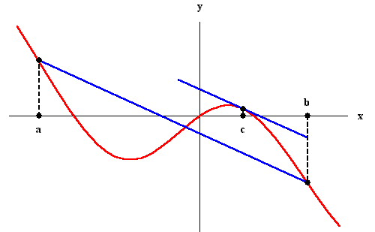
The special case, when f(a) = f(b) is known as Rolle's Theorem. In this case, we have f '(c) =0.

Slide 11
Mean Value Theorem- MVT
f
If: f is continuous on [a, b],
differentiable on (a, b)
Then: there is a c in (a, b) such that
a
b
c

Slide 12
Example
(f is continuous and differentiable)
MVT applies

Slide 13
Indeterminate Forms and l’Hospital’s Rule

Slide 14
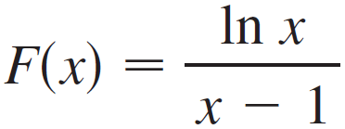
Indeterminate Forms and l’Hospital’s Rule
Suppose we are trying to analyze the behavior of the function
Although F is not defined when x = 1, we need to know how F behaves near 1. In particular, we would like to know the value of the limit

Slide 15
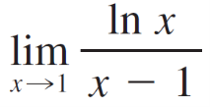
Indeterminate Forms and l’Hospital’s Rule
In computing this limit we can’t apply Law 5 of limits because the limit of the denominator is 0. In fact, although the limit in exists, its value is not obvious because both numerator and denominator approach 0 and is not defined.
In general, if we have a limit of the form
where both f (x) → 0 and g (x) → 0 as x → a, then this limit may or may not exist and is called an indeterminate form of type .

Slide 16
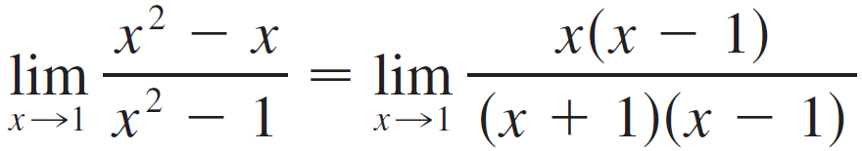
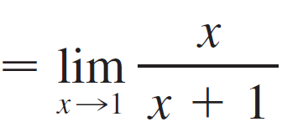
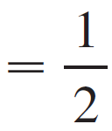
Indeterminate Forms and l’Hospital’s Rule
For rational functions, we can cancel common factors:
We used a geometric argument to show that

Slide 17

Indeterminate Forms and l’Hospital’s Rule
But these methods do not work for limits such as , so in this section we introduce a systematic method, known as l’Hospital’s Rule, for the evaluation of indeterminate forms.
Another situation in which a limit is not obvious occurs when we look for a horizontal asymptote of F and need to evaluate its limit at infinity:
It isn’t obvious how to evaluate this limit because both numerator and denominator become large as x → .

Slide 18
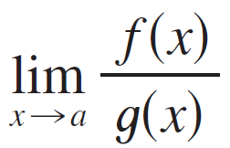
Indeterminate Forms and l’Hospital’s Rule
There is a struggle between numerator and denominator. If the numerator wins, the limit will be ; if the denominator wins, the answer will be 0. Or there may be some compromise, in which case the answer will be some finite positive number.
In general, if we have a limit of the form
where both f (x) → (or – ) and g (x) → (or – ), then the limit may or may not exist and is called an indeterminate form of type / .

Slide 19
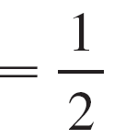
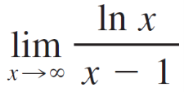
Indeterminate Forms and l’Hospital’s Rule
This type of limit can be evaluated for certain functions, including rational functions, by dividing numerator and denominator by the highest power of that occurs in the denominator. For instance,
This method does not work for limits such as .

Slide 20
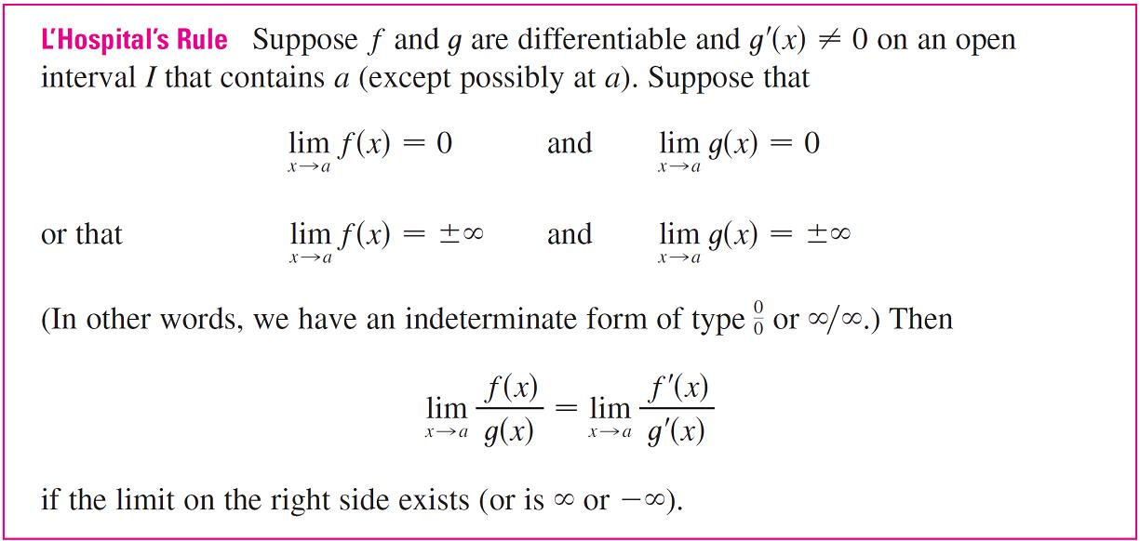
Indeterminate Forms and l’Hospital’s Rule
L’Hospital’s Rule applies to this type of indeterminate form.

Slide 21
Indeterminate Forms and l’Hospital’s Rule
Note 1:
L’Hospital’s Rule says that the limit of a quotient of functions is equal to the limit of the quotient of their derivatives, provided that the given conditions are satisfied. It is especially important to verify the conditions regarding the limits of f and g before using l’Hospital’s Rule.
Note 2:
L’Hospital’s Rule is also valid for one-sided limits and for limits at infinity or negative infinity; that is, “x → a” can be replaced by any of the symbols x → a⁺, x → a–, x → , or x → – .

Slide 22
Indeterminate Forms and l’Hospital’s Rule
Note 3:
For the special case in which f (a) = g(a) = 0, f ′ and g ′ are continuous, and g ′(a) ≠ 0, it is easy to see why l’Hospital’s Rule is true. In fact, using the alternative form of the definition of a derivative, we have

Slide 23
Indeterminate Forms and l’Hospital’s Rule
It is more difficult to prove the general version of l’Hospital’s Rule.

Slide 24
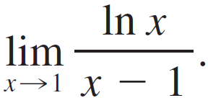
Example 1
Find
Solution:
Since
and

Slide 25
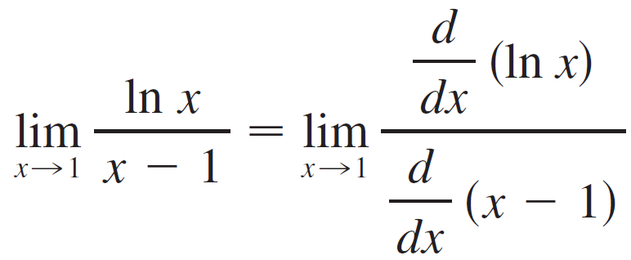
Example 1 – Solution
cont’d
we can apply l’Hospital’s Rule:

Slide 26
Indeterminate Products

Slide 27
Indeterminate Products
If lim_{x→a} f (x) = 0 and lim_{x→a} g(x) = (or – ), then it isn’t clear what the value of lim_{x→a} [f (x) g(x)], if any, will be. There is a struggle between f and g. If f wins, the answer will be 0; if g wins, the answer will be (or – ).
Or there may be a compromise where the answer is a finite nonzero number. This kind of limit is called an indeterminate form of type 0  .

Slide 28
Indeterminate Products
We can deal with it by writing the product fg as a quotient:
This converts the given limit into an indeterminate form of type or / so that we can use l’Hospital’s Rule.

Slide 29
Example 6
Evaluate
Solution:
The given limit is indeterminate because, as x → 0⁺, the first factor (x) approaches 0 while the second factor (ln x) approaches – .

Slide 30
Example 6 – Solution
cont’d
Writing x = 1/(1/x), we have 1/x → as x → 0⁺, so l’Hospital’s Rule gives
= 0

Slide 31
Indeterminate Products
Note:
In solving Example 6 another possible option would have been to write
This gives an indeterminate form of the type 0/0, but if we apply l’Hospital’s Rule we get a more complicated expression than the one we started with.
In general, when we rewrite an indeterminate product, we try to choose the option that leads to the simpler limit.

Slide 32
Indeterminate Differences

Slide 33
Indeterminate Differences
If lim_{x→a} f (x) = and lim_{x→a} g(x) = , then the limit
is called an indeterminate form of type – . Again there is a contest between and .
Will the answer be (f wins) or will it be – (g wins) or will they compromise on a finite number? To find out, we try to convert the difference into a quotient (for instance, by using a common denominator, or rationalization, or factoring out a common factor) so that we have an indeterminate form of type or / .

Slide 34
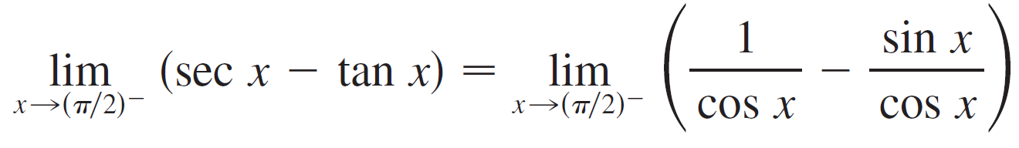
Example 7
Compute
Solution:
First notice that sec x → and tan x → as x → (π /2)–, so the limit is indeterminate.
Here we use a common denominator:

Slide 35

Example 7 – Solution
cont’d
Note that the use of l’Hospital’s Rule is justified because
1 – sin x → 0 and cos x → 0 as x → (π /2)–.

Slide 36
Indeterminate Powers

Slide 37
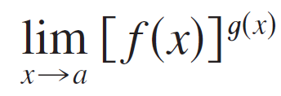

Indeterminate Powers
Several indeterminate forms arise from the limit
1. and type 0⁰
2. and type ⁰
3. and type

Slide 38
Indeterminate Powers
Each of these three cases can be treated either by taking the natural logarithm:
let y = [f (x)]^{g (x)}, then ln y = g(x) ln f (x)
or by writing the function as an exponential:
[f (x)]^{g(x)} = e^{g (x) ln f (x)}
In either method we are led to the indeterminate product
g(x) ln f (x), which is of type 0  .

Slide 39
Example 8
Calculate
Solution:
First notice that as x → 0⁺, we have 1 + sin 4x → 1 and
cot x → , so the given limit is indeterminate. Let
y = (1 + sin 4x)^{cot x}
Then
ln y = ln[(1 + sin 4x)^{cot x}] = cot x ln(1 + sin 4x)

Slide 40

Example 8 – Solution
cont’d
so l’Hospital’s Rule gives
So far we have computed the limit of ln y, but what we want is the limit of y.
To find this we use the fact that y = e^{lny}:

Slide 41
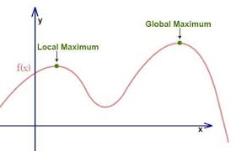
MAXIMUM & MINIMUM VALUES
Definition
A function f has an absolute maximum (or global maximum) at c if f(c) ≥ f(x) for all x in D, where D is the domain of f.
The number f(c) is called the maximum value of f on D.

Slide 42
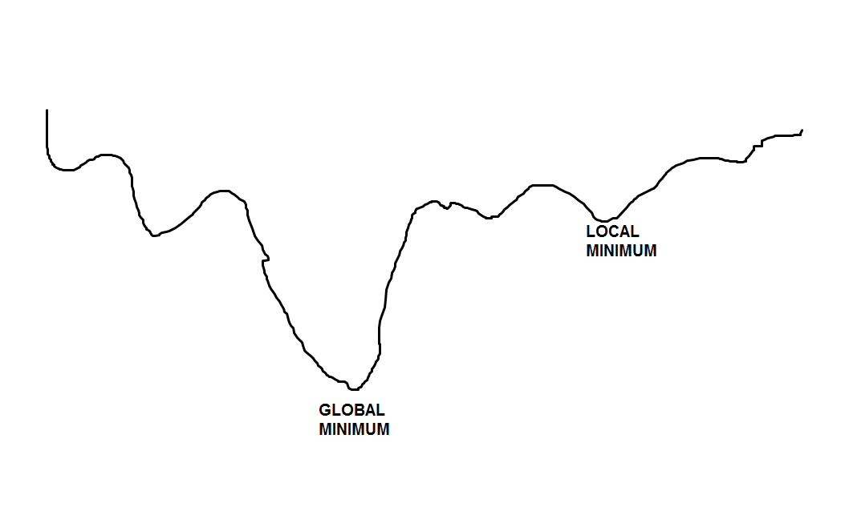
MAXIMUM & MINIMUM VALUES
Definition
Similarly, f has an absolute minimum at c if f(c) ≤ f(x) for all x in D and the number f(c) is called the minimum value of f on D.
The maximum and minimum values of f are called the extreme values of f.

Slide 43
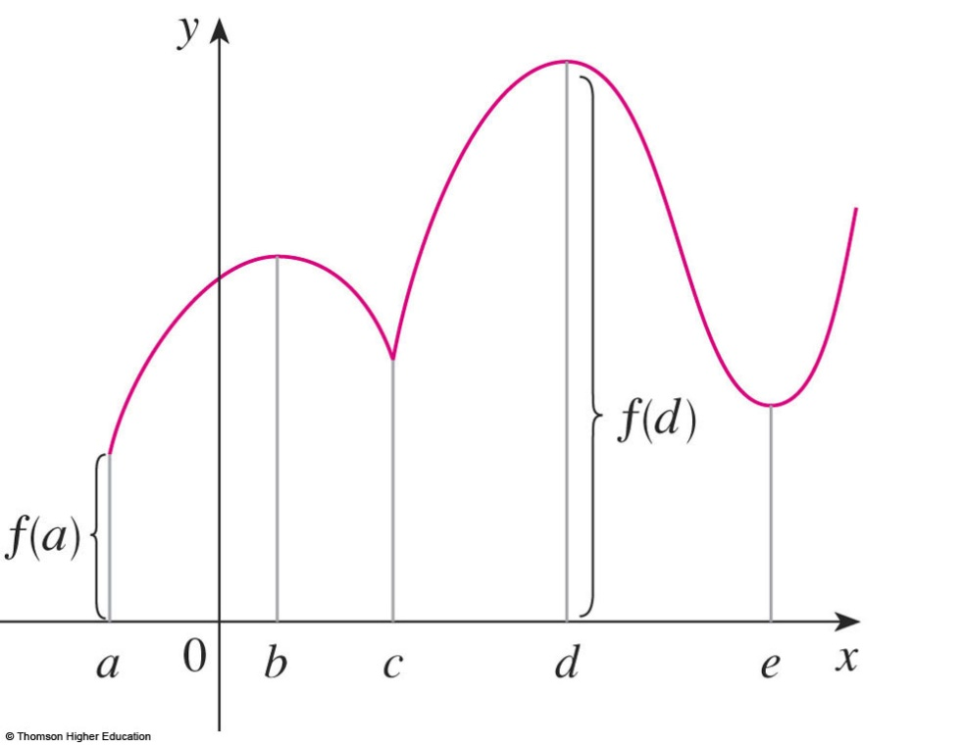
MAXIMUM & MINIMUM VALUES
The figure shows the graph of a function f
with absolute maximum at d and absolute minimum at a.
  Note that (d, f(d)) is
  the highest point on
  the graph and (a, f(a))
  is the lowest point.

Slide 44
LOCAL MAXIMUM VALUE
If we consider only values of x near b—for instance, if we restrict our attention to the interval (a, c)—then f(b) is the largest of those values of f(x).
  It is called a local
  maximum value of f.

Slide 45
LOCAL MINIMUM VALUE
Likewise, f(c) is called a local minimum value of f because f(c) ≤ f(x) for x near c—for instance, in the interval (b, d).
  The function f also has
  a local minimum at e.

Slide 46
MAXIMUM & MINIMUM VALUES
Definition 2
In general, we have the following definition.
A function f has a local maximum (or relative maximum) at c if f(c) ≥ f(x) when x is near c.
  This means that f(c) ≥ f(x) for all x in some
  open interval containing c.
  Similarly, f has a local minimum at c if f(c) ≤ f(x)
  when x is near c.

Slide 47
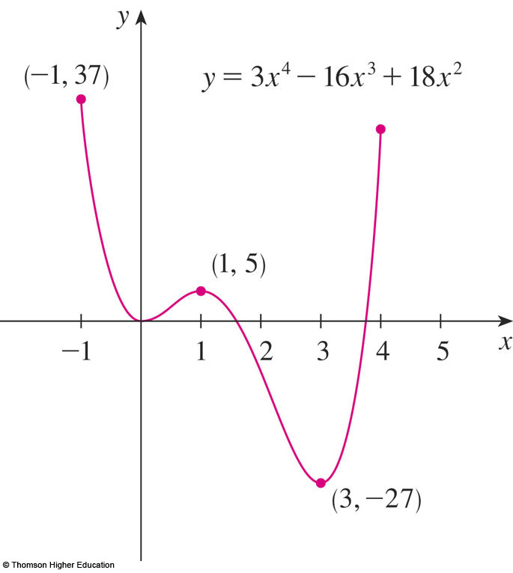
MAXIMUM & MINIMUM VALUES
Example 4
The graph of the function
f(x) = 3x⁴ – 16x³ + 18x² -1 ≤ x ≤ 4
is shown here.

Slide 48
MAXIMUM & MINIMUM VALUES
Example 4
The graph of the function
f(x) = 3x⁴ – 16x³ + 18x² -1 ≤ x ≤ 4
is shown here.

Slide 49
MAXIMUM & MINIMUM VALUES
Example 4
Also, f(0) = 0 is a local minimum and
f(3) = -27 is both a local and an absolute minimum.
  Note that f has
  neither a local nor
  an absolute maximum
  at x = 4.

Slide 50
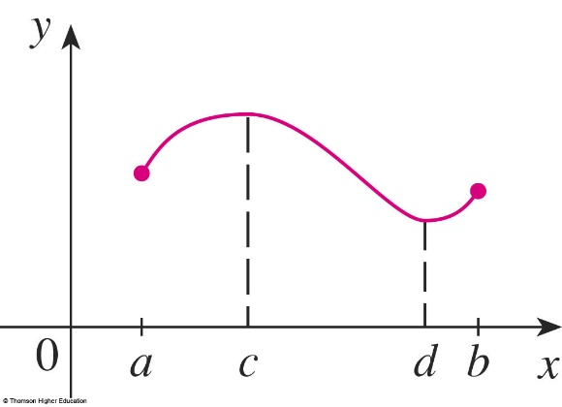
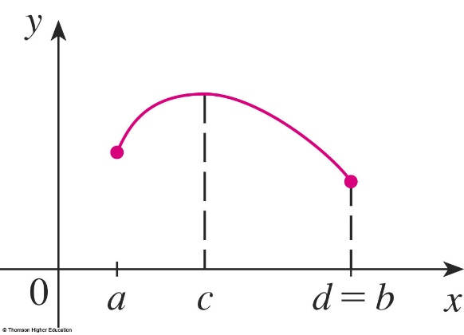
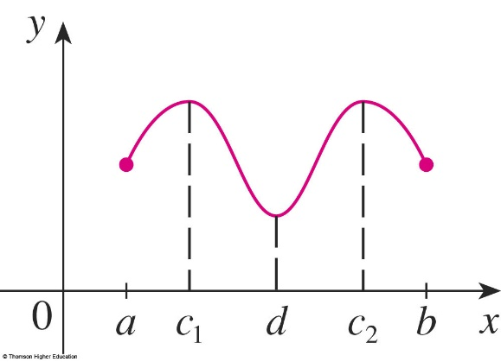
EXTREME VALUE THEOREM
EXTREME VALUE THEOREM
If f is continuous on a closed interval [a, b], then f attains an absolute maximum value f(c) and an absolute minimum value f(d) at some numbers c and d in [a, b].
The theorem is illustrated in the figures.
  Note that an extreme value
  can be taken on more than once.

Slide 51
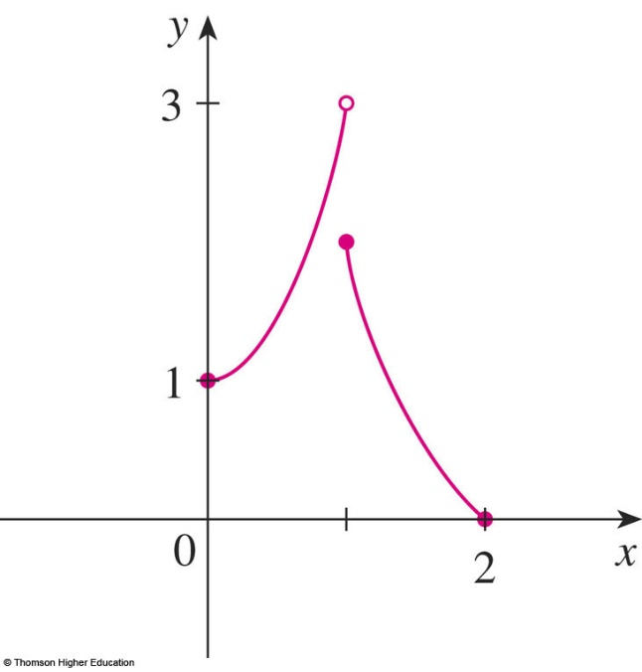
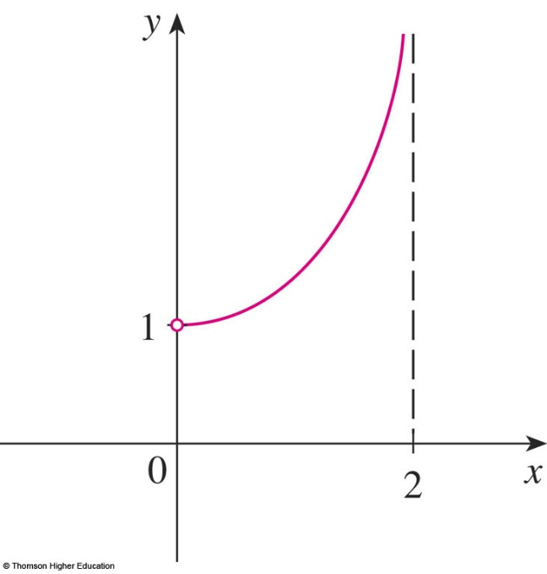
EXTREME VALUE THEOREM
The figures show that a function need not possess extreme values if either hypothesis (continuity or closed interval) is omitted from the theorem.

Slide 52
EXTREME VALUE THEOREM
The function f whose graph is shown is defined on the closed interval [0, 2] but has
no maximum value.
  Notice that the range of f
  is [0, 3).
  The function takes on values
  arbitrarily close to 3, but never
  actually attains the value 3.

Slide 53
EXTREME VALUE THEOREM
This does not contradict the theorem because f is not continuous.
  Nonetheless, a discontinuous
  function could have maximum
  and minimum values.

Slide 54
EXTREME VALUE THEOREM
The function g shown here is continuous
on the open interval (0, 2) but has neither
a maximum nor a minimum value.
  The range of g is (1, ∞).
  The function takes on
  arbitrarily large values.
  This does not contradict
  the theorem because
  the interval (0, 2) is not closed.

Slide 55
EXTREME VALUE THEOREM
The theorem says that a continuous function on a closed interval has a maximum value
and a minimum value.
However, it does not tell us how to find these extreme values.
  We start by looking for local extreme values.

Slide 56
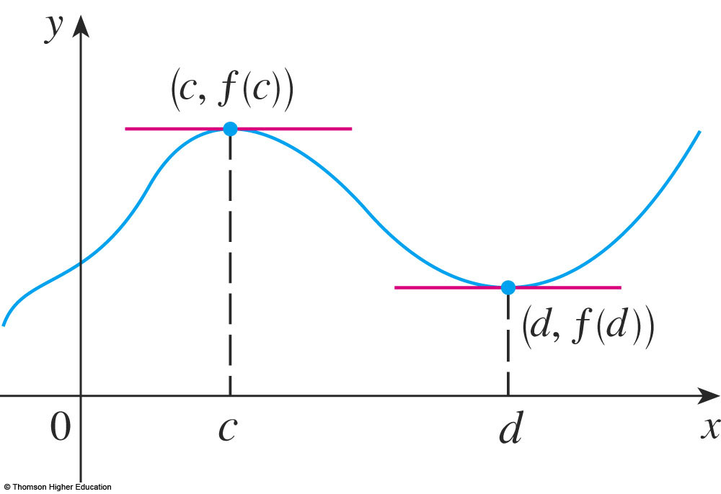
LOCAL EXTREME VALUES
The figure shows the graph of a function f
with a local maximum at c and a local minimum at d.

Slide 57
LOCAL EXTREME VALUES
It appears that, at the maximum and minimum points, the tangent lines are horizontal and therefore each has slope 0.

Slide 58
LOCAL EXTREME VALUES
We know that the derivative is the slope
of the tangent line.
  So, it appears that f ’(c) = 0 and f ’(d) = 0.

Slide 59
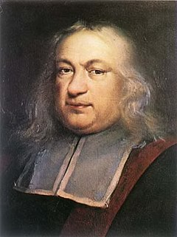
FERMAT’S THEOREM
Theorem 4
If f has a local maximum or
minimum at c, and if f ’(c) exists, then f ’(c) = 0.
Pierre de Fermat
1601-1665

Slide 60
FERMAT’S THEOREM
Proof
Suppose, for the sake of definiteness, that f has a local maximum at c.
Then, according to Definition 2, f(c) ≥ f(x)
if x is sufficiently close to c.

Slide 61
FERMAT’S THEOREM
Proof (Equation 5)
This implies that, if h is sufficiently close to 0, with h being positive or negative, then
f(c) ≥ f(c + h)
and therefore
f(c + h) – f(c) ≤ 0

Slide 62
FERMAT’S THEOREM
Proof
We can divide both sides of an inequality by a positive number.
  Thus, if h > 0 and h is sufficiently small,
  we have:

Slide 63
FERMAT’S THEOREM
Proof
Taking the right-hand limit of both sides
of this inequality (using Theorem 2 in Section 2.3), we get:

Slide 64
FERMAT’S THEOREM
Proof
However, since f ’(c) exists,
we have:
  So, we have shown that f ’(c) ≤ 0.

Slide 65
FERMAT’S THEOREM
Proof
If h < 0, then the direction of the inequality in Equation 5 is reversed when we divide by h:

Slide 66
FERMAT’S THEOREM
Proof
So, taking the left-hand limit,
we have:

Slide 67
FERMAT’S THEOREM
Proof
We have shown that f ’(c) ≥ 0 and also
that f ’(c) ≤ 0.
Since both these inequalities must be true, the only possibility is that f ’(c) = 0.

Slide 68
FERMAT’S THEOREM
Proof
We have proved the theorem for
the case of a local maximum.
  The case of a local minimum can be proved
  in a similar manner.

Slide 69
CRITICAL NUMBERS
Definition 6
A critical number of a function f is
a number c in the domain of f such that either f ’(c) = 0 or f ’(c) does not exist.
If f has a local maximum or
minimum at c, then c is a critical number of f.

Slide 70
CRITICAL NUMBERS
Example 7
Find the critical numbers of
f(x) = x^{3/5}(4 - x).
  The Product Rule gives:

Slide 71
CRITICAL NUMBERS
Example 7
  The same result could be obtained by
  first writing f(x) = 4x^{3/5} – x^{8/5}.
  Therefore, f ’(x) = 0 if 12 – 8x = 0.
  That is, x = , and f ’(x) does not exist
  when x = 0.
  Thus, the critical numbers are and 0.

Slide 72
CLOSED INTERVALS
To find an absolute maximum or minimum
of a continuous function on a closed interval, we note that either:
  It is local (in which case, it occurs at
  a critical number).
  It occurs at an endpoint of the interval.

Slide 73
CLOSED INTERVAL METHOD
To find the absolute maximum and minimum values of a continuous function f on a closed interval [a, b]:
  Find the values of f at the critical numbers of f
  in (a, b).
  Find the values of f at the endpoints of the interval.
  The largest value from 1 and 2 is the absolute maximum value. The smallest is the absolute minimum value.

Slide 74
CLOSED INTERVAL METHOD
Example
Find the absolute maximum
and minimum values of the function
f(x) = x³ – 3x² + 1 -½ ≤ x ≤ 4

Slide 75
CLOSED INTERVAL METHOD
As f is continuous on [-½, 4], we
can use the Closed Interval Method:
f(x) = x³ – 3x² + 1
f ’(x) = 3x² – 6x = 3x(x – 2)

Slide 76
CLOSED INTERVAL METHOD
As f ’(x) exists for all x, the only critical numbers of f occur when f ’(x) = 0, that is, x = 0 or x = 2.
Notice that each of these numbers lies in
the interval (-½, 4).

Slide 77
CLOSED INTERVAL METHOD
The values of f at these critical numbers
are: f(0) = 1 f(2) = -3
The values of f at the endpoints of the interval are: f(-½) = 1/8 f(4) = 17
  Comparing these four numbers, we see that
  the absolute maximum value is f(4) = 17 and
  the absolute minimum value is f(2) = -3.

Slide 78
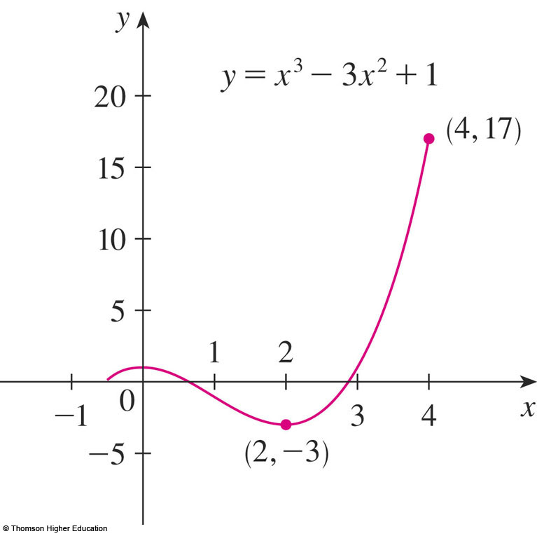
CLOSED INTERVAL METHOD
CLOSED INTERVAL METHOD
CLOSED INTERVAL METHOD
Note that the absolute maximum occurs
at an endpoint, whereas the absolute minimum occurs at a critical number.
The graph of f is sketched here.

Slide 79
Higher Derivatives
The second derivative of a function f is the derivative of the derivative of f at a point x in the domain of the first derivative.
Derivative
Notations
Second
Third
Fourth
nth

Slide 80
Example of Higher Derivatives
Given
find

Slide 81
Example of Higher Derivatives
Given
find

Slide 82
Implicit Differentiation
y is expressed explicitly as a function of x.
y is expressed implicitly as a function of x.
To differentiate the implicit equation, we write f (x) in place of y to get:

Slide 83
Implicit Differentiation (cont.)
Now differentiate
using the chain rule:
which can be written in the form
subbing in y
Solve for y’

Slide 84
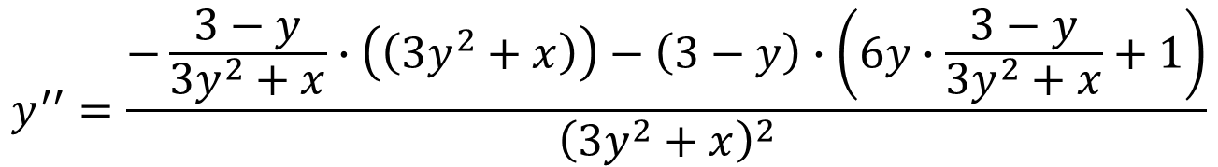
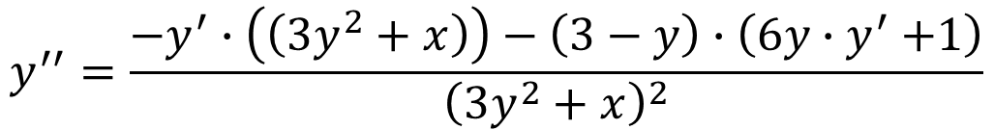
Calculating the second derivative
$$y^{′′}=\frac{−y^{′}∙\left(\left(3y^{2}+x\right)\right)−\left(3−y\right)∙\left(6y{∙y}^{′}+1\right)}{{\left(3y^{2}+x\right)}^{2}}$$
Deriving again respect to x:
Substituting $y^{′} into the formula we get the final answer:$
$$y^{′′}=\frac{−\frac{3−y}{3y^{2}+x}∙\left(\left(3y^{2}+x\right)\right)−\left(3−y\right)∙\left(6y∙\frac{3−y}{3y^{2}+x}+1\right)}{{\left(3y^{2}+x\right)}^{2}}$$

Slide 85

Leibniz Formula
The Leibniz formula expresses the derivative on nth order of the product of two functions. Suppose that the functions u(x) and v(x) have the derivatives up to nth order. Consider the derivative of the product of these functions.
The first derivative is described by the well known formula:
$${\left(uv\right)}^{′}=u^{′}v+uv^{′}$$
Differentiating this expression again yields the second derivative:
${\left(uv\right)}^{′′}={\left(u^{′}v+uv^{′}\right)}^{′}=u^{′′}v+u^{′}v^{′}+u^{′}v^{′}$+$uv^{′′}=u^{′′}v+{2u}^{′}v^{′}+uv^{′′}$
Likewise, we can find the third derivative of the product $uv:$
$${\left(uv\right)}^{′′′}=u^{′′′}v+3u^{′′}v^{′}+3u^{′}v^{′′}+uv^{′′′}$$

Slide 86
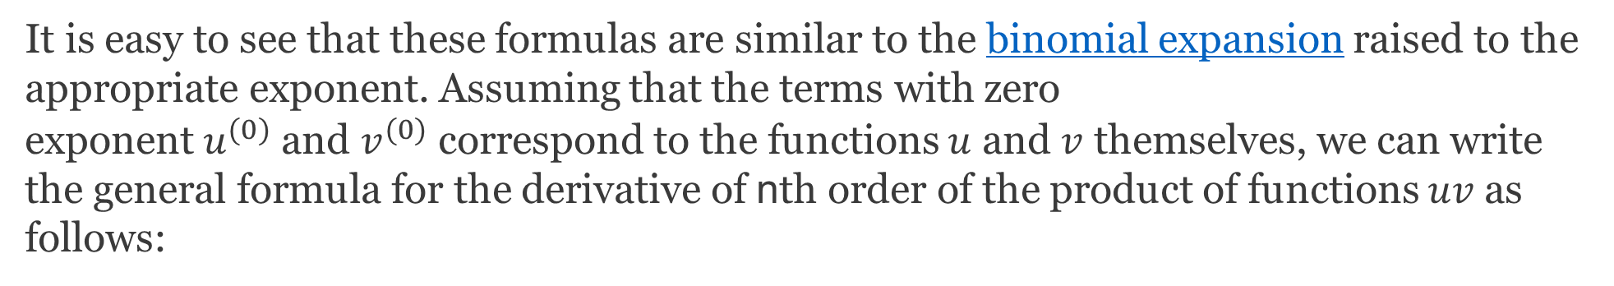
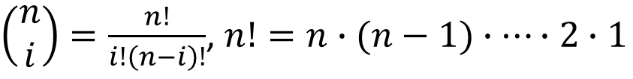
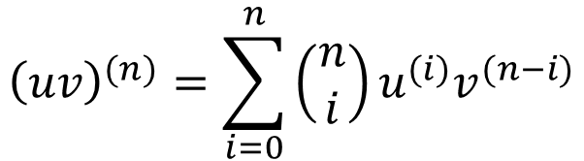
Leibniz Formula
It is easy to see that these formulas are similar to the binomial expansion raised to the appropriate exponent. Assuming that the terms with zero exponent $u^{(0)}$ and $v^{(0)}$ correspond to the functions $u$ and $v$ themselves, we can write the general formula for the derivative of nth order of the product of functions $uv$ as follows:
$${\left(uv\right)}^{(n)}=\sum_{i=0}^{n}{\left(\begin{matrix}n \\ i\end{matrix}\right)u^{(i)}v^{(n−i)}}$$
where
$\left(\begin{matrix}n \\ i\end{matrix}\right)=\frac{n!}{i!\left(n−i\right)!}$, $n!=n∙(n−1)∙⋯∙2∙1$

Slide 92
…

Slide 94
Taylor’s Theorem
If the function f and its first n+1 derivatives are continuous on an interval containing a and x, then the value of the function at x is given by
where remainder R_{n} is defined as

Slide 95
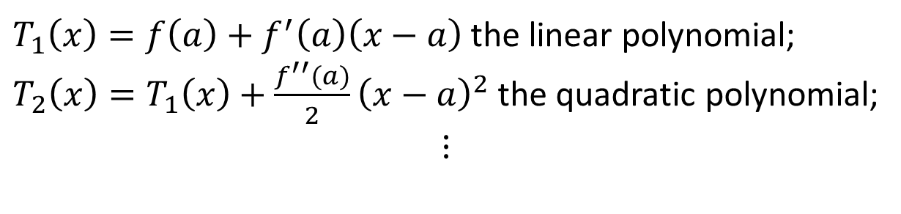
Taylor’s Theorem
$$T_{n}\left(x\right)=f\left(a\right)+\frac{f^{′}\left(a\right)}{1!}\left(x−a\right)+\frac{f^{′′}(a)}{2!}{\left(x−a\right)}^{2}+⋯+\frac{f^{\left(n\right)}(a)}{n!}{\left(x−a\right)}^{n}$$
Is the nth ordered Taylor polynomial.
$T_{1}\left(x\right)=f\left(a\right)+f^{′}\left(a\right)\left(x−a\right)$ the linear polynomial;
$T_{2}\left(x\right)=T_{1}\left(x\right)+\frac{f^{′′}(a)}{2}{\left(x−a\right)}^{2}$ the quadratic polynomial;
$$⋮$$

Slide 96
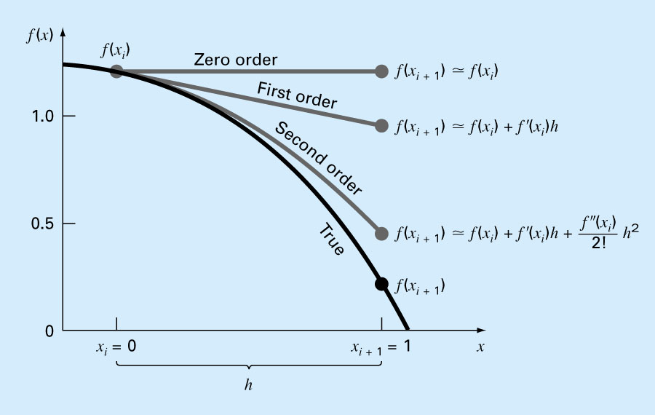
Approximation withTaylor polinomyals
96

Slide 97

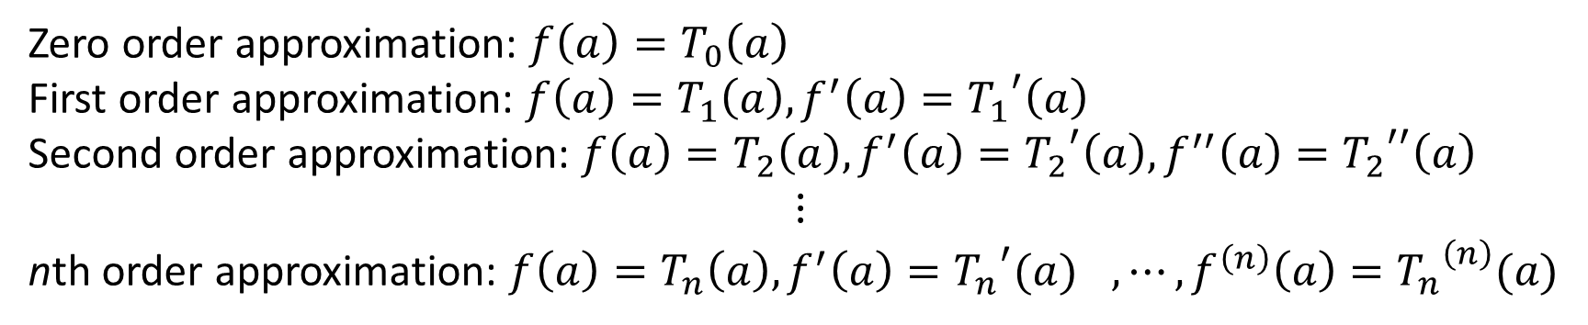
Approximation withTaylor polinomyals
$$f(x)≈T_{n}(x)$$
Zero order approximation: $f\left(a\right)=T_{0}\left(a\right)$
First order approximation: $f\left(a\right)=T_{1}\left(a\right),f^{′}\left(a\right)={T_{1}}^{′}\left(a\right)$
Second order approximation: $f\left(a\right)=T_{2}\left(a\right),f^{′}\left(a\right)={T_{2}}^{′}\left(a\right),f^{′′}\left(a\right)={T_{2}}^{′′}\left(a\right)$
$$⋮$$
nth order approximation: $f\left(a\right)={T_{n}\left(a\right),f^{′}\left(a\right)={T_{n}}^{′}(a)}^{},⋯,f^{\left(n\right)}\left(a\right)={T_{n}}^{\left(n\right)}(a)$

