Slide 1
Practice
Taylor polinomials, Implicite differentation, MVT, higher derivatives, L’Hospital Rule

Slide 2
Taylor’s Theorem
If the function f and its first n+1 derivatives are continuous on an interval containing a and x, then the value of the function at x is given by
where remainder R_{n} is defined as

Slide 3
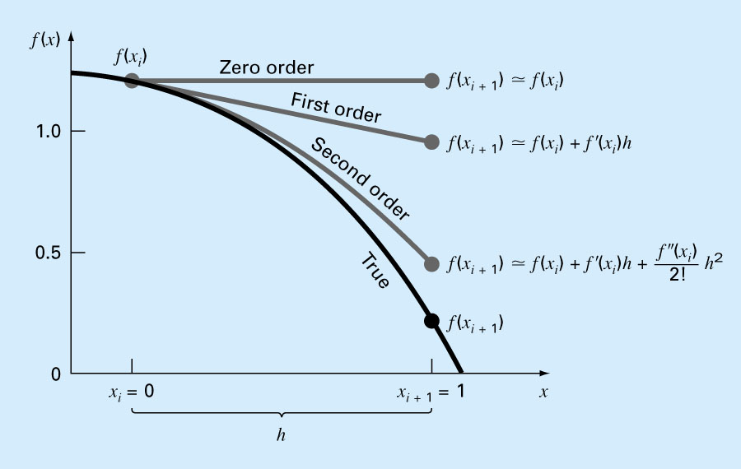
Approximation withTaylor polinomyals
3

Slide 4

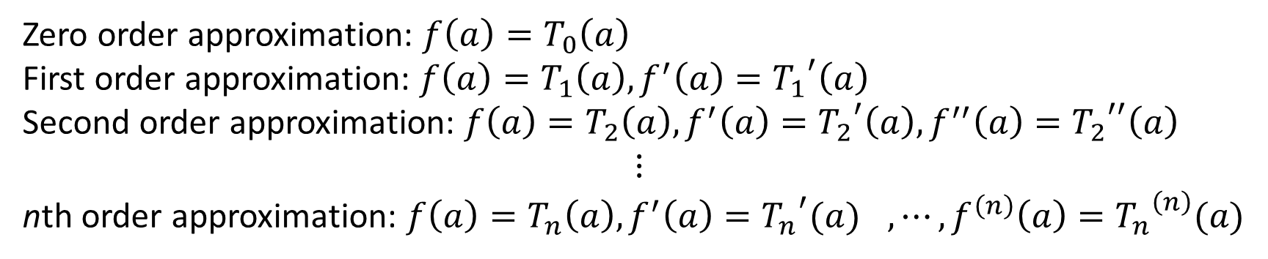
Approximation withTaylor polinomyals
$$f(x)≈T_{n}(x)$$
Zero order approximation: $f\left(a\right)=T_{0}\left(a\right)$
First order approximation: $f\left(a\right)=T_{1}\left(a\right),f^{′}\left(a\right)={T_{1}}^{′}\left(a\right)$
Second order approximation: $f\left(a\right)=T_{2}\left(a\right),f^{′}\left(a\right)={T_{2}}^{′}\left(a\right),f^{′′}\left(a\right)={T_{2}}^{′′}\left(a\right)$
$$⋮$$
nth order approximation: $f\left(a\right)={T_{n}\left(a\right),f^{′}\left(a\right)={T_{n}}^{′}(a)}^{},⋯,f^{\left(n\right)}\left(a\right)={T_{n}}^{\left(n\right)}(a)$

Slide 6
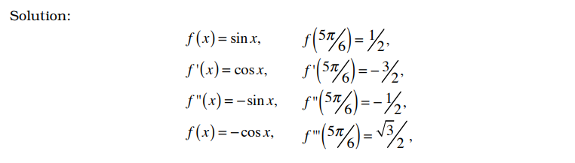
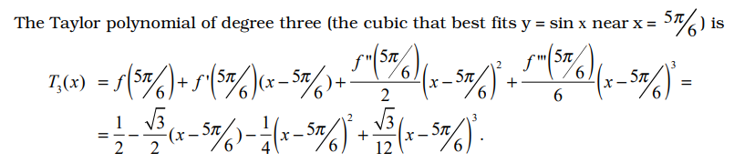

Slide 9
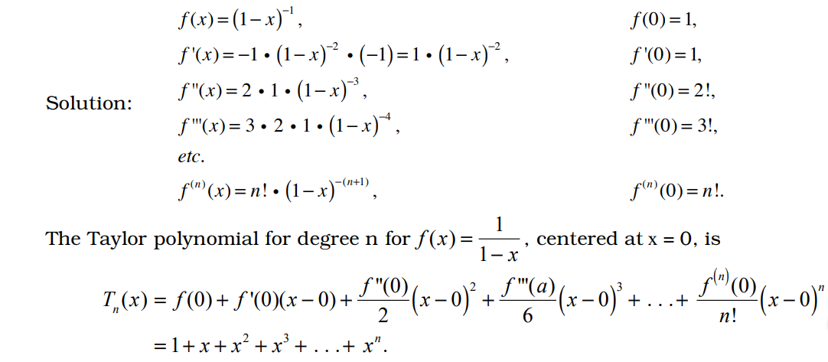

Slide 10
1/a
1/b

Slide 11
2.)

Slide 12
3/a
3/b
3/c

Slide 13
4/a
4/b
4/c

