Slide 1
Implicite Differentation

Slide 2
Implicit Differentiation
So far, all the equations and functions we looked at were all stated explicitly in terms of one variable:
In this function, y is defined explicitly in terms of x. If we re-wrote it as xy = 1, y is now defined implicitly in terms of x.
It is easy to find the derivative of an explicit function, but what about:

Slide 3

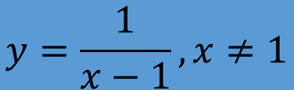
Explicite and implicite definition of a function
$$y=f\left(x\right) an explicite \left(usual\right) definition of a real function.$$
$$y=\frac{1}{x−1},x≠1$$
$$F\left(x,y\right)=0, where \left(x,y\right)∈ℝ×ℝ is an implicite definition of a function between x and y.$$
$$yx−y−1=0, x≠1$$

Slide 4
IMPLICIT DIFFERENTIATION
Some other examples of implicit functions are:
(Equation 1) x² + y² = 25
(Equation 2) x³ + y³ = 6xy
In some cases (Eq. 1.), it is possible to solve such an equation for y as an explicit function (or several functions) of x.
  For instance, if we solve Equation 1 for y,
  we get
  So, two of the functions determined by
  the implicit Equation 1 are
  and

Slide 5
This is not a function, but it would still be nice to be able to find the slope.
Do the same thing to both sides.
Note use of chain rule.

Slide 6
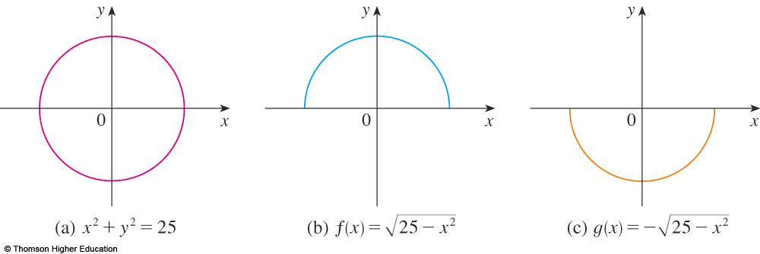
The graphs of f and g are the upper
and lower semicircles of the circle
x² + y² = 25.

Slide 7
It’s not easy to solve Equation 2 for y explicitly as a function of x by hand.
  A computer algebra system has no trouble.
  However, the expressions it obtains are
  very complicated.

Slide 8
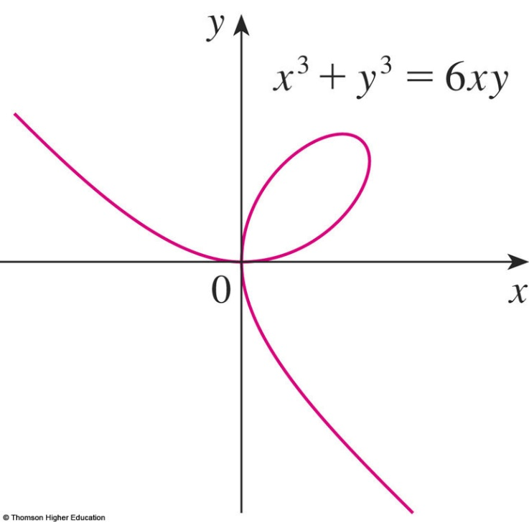
FOLIUM OF DESCARTES
Nonetheless, Equation 2 is the equation
of a curve called the folium of Descartes shown here and it implicitly defines y as several functions of x.

Slide 9
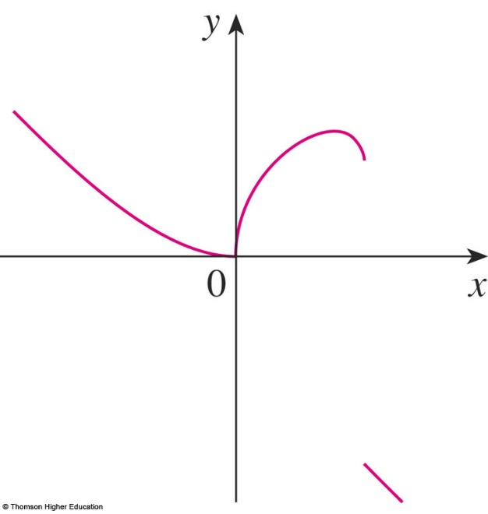
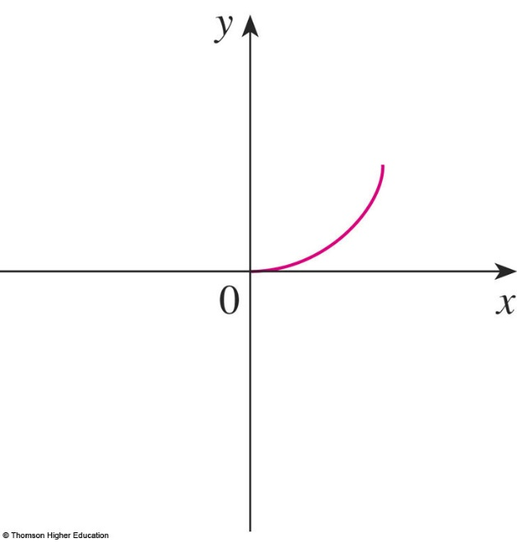
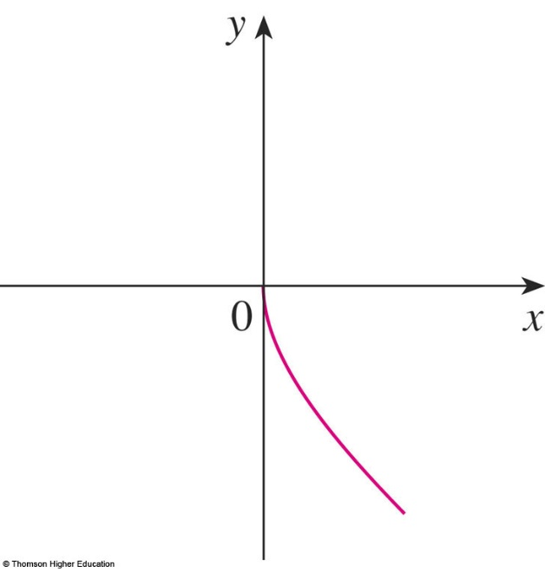
FOLIUM OF DESCARTES
The graphs of three functions defined by the folium of Descartes are shown.

Slide 10
IMPLICIT DIFFERENTIATION
When we say that f is a function defined implicitly by Equation 2, we mean that the equation x³ + [f(x)]³ = 6x f(x) is true for all values of x in the domain of f.
Fortunately, we don’t need to solve an equation for y in terms of x to find the derivative of y.
Instead, we can use the method of implicit differentiation.
  This consists of differentiating both sides of
  the equation with respect to x and then solving
  the resulting equation for y’.

Slide 11
IMPLICIT DIFFERENTIATION
In the examples, it is always assumed that the given equation determines y implicitly as a differentiable function of x so that the method of implicit differentiation can be applied.
Example 1
a. If x² + y² = 25, find .
b. Find an equation of the tangent to the circle x² + y² = 25 at the point (3, 4).

Slide 12
IMPLICIT DIFFERENTIATION
Example 1 a
Differentiate both sides of the equation
x² + y² = 25:

Slide 13
IMPLICIT DIFFERENTIATION
Example 1 a
Remembering that y is a function of x and using the Chain Rule, we have:
Then, we solve this equation for :

Slide 14
IMPLICIT DIFFERENTIATION
E. g. 1 b—Solution 1
At the point (3, 4) we have x = 3 and y = 4.
So,
  Thus, an equation of the tangent to the circle at (3, 4)
  is: y – 4 = – ¾(x – 3) or 3x + 4y = 25.

Slide 15
IMPLICIT DIFFERENTIATION
E. g. 1 b—Solution 2
Solving the equation x² + y² = 25,
we get:
  The point (3, 4) lies on the upper semicircle
  So, we consider the function

Slide 16
IMPLICIT DIFFERENTIATION
E. g. 1 b—Solution 2
Differentiating f using the Chain Rule, we have:

Slide 17
IMPLICIT DIFFERENTIATION
E. g. 1 b—Solution 2
So,
  As in Solution 1, an equation of the tangent is
  3x + 4y = 25.

Slide 18
NOTE 1
The expression dy/dx = -x/y in Solution 1 gives the derivative in terms of both x and y.
It is correct no matter which function y is determined by the given equation.
For instance, for ,
we have:
However, for ,
we have:

Slide 19
IMPLICIT DIFFERENTIATION
Example 2
a. Find y’ if x³ + y³ = 6xy.
b. Find the tangent to the folium of Descartes x³ + y³ = 6xy at the point (3, 3).
c. At what points in the first quadrant is
the tangent line horizontal?

Slide 20
IMPLICIT DIFFERENTIATION
Example 2 a
Differentiating both sides of x³ + y³ = 6xy with respect to x, regarding y as a function of x, and using the Chain Rule on y³ and the Product Rule on 6xy, we get:
3x² + 3y²y’ = 6xy’ + 6y
or x² + y²y’ = 2xy’ + 2y

Slide 21
IMPLICIT DIFFERENTIATION
Example 2 a
Now, we solve for y’:

Slide 22
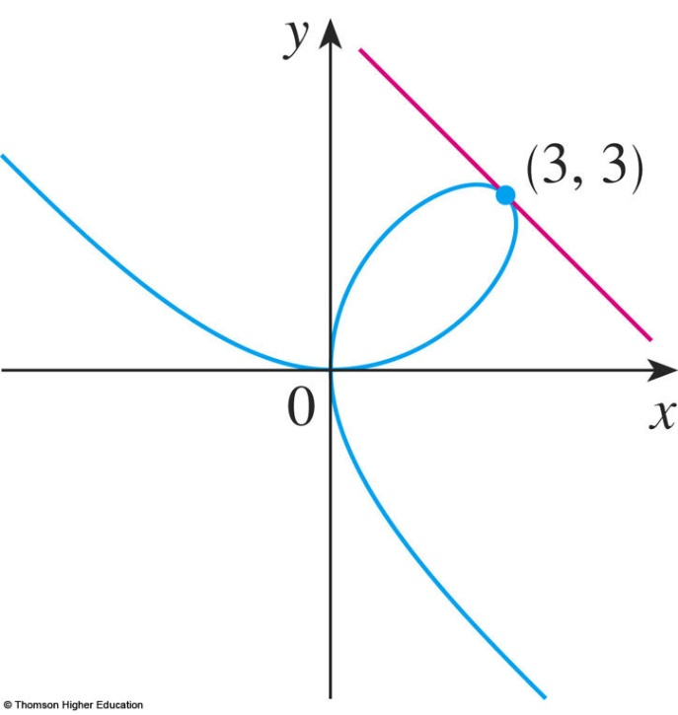
IMPLICIT DIFFERENTIATION
Example 2 b
When x = y = 3,
  A glance at the figure confirms
  that this is a reasonable value
  for the slope at (3, 3).
  So, an equation of the tangent
  to the folium at (3, 3) is:
  y – 3 = – 1(x – 3) or x + y = 6.

Slide 23
IMPLICIT DIFFERENTIATION
Example 2 c
The tangent line is horizontal if y’ = 0.
  Using the expression for y’ from (a), we see that y’ = 0 when 2y – x² = 0 (provided that y² – 2x ≠ 0).
  Substituting y = ½x² in the equation of the curve,
  we get x³ + (½x²)³ = 6x(½x²) which simplifies to
  x⁶ = 16x³.

Slide 24
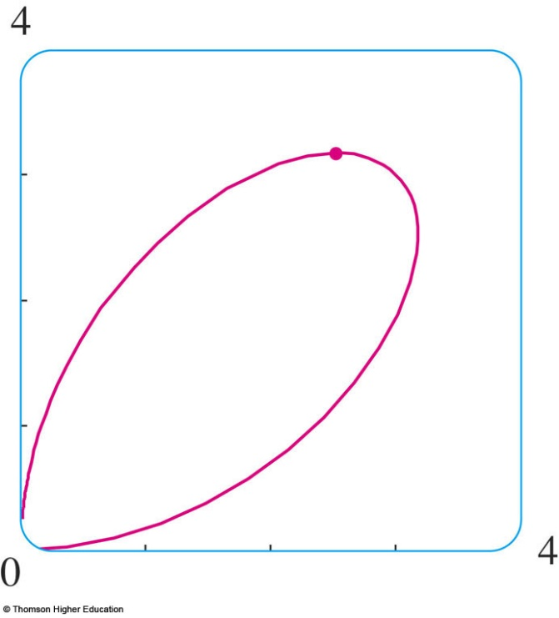
IMPLICIT DIFFERENTIATION
IMPLICIT DIFFERENTIATION
Example 2 c
Since x ≠ 0 in the first quadrant, we have x³ = 16.
If x = 16^{1/3} = 2^{4/3}, then y = ½(2^{8/3}) = 2^{5/3}.
Thus, the tangent is horizontal at (0, 0)
and at (2^{4/3}, 2^{5/3}), which is approximately (2.5198, 3.1748).
  Looking at the figure, we see
  that our answer is reasonable.

Slide 25
NOTE 2
There is a formula for the three roots of a cubic equation that is like the quadratic formula, but much more complicated.
If we use this formula (or a computer algebra system) to solve the equation x³ + y³ = 6xy
for y in terms of x, we get three functions determined by the following equation.
and

Slide 26
NOTE 2
These are the three functions whose graphs are shown in the earlier figure.

Slide 27
NOTE 2
You can see that the method of implicit differentiation saves an enormous amount of work in cases such as this.
Moreover, implicit differentiation works just as easily for equations such as
y⁵ + 3x²y² + 5x⁴ = 12
for which it is impossible to find a similar expression for y in terms of x.

Slide 28
IMPLICIT DIFFERENTIATION
Example 3
Find y’ if sin(x + y) = y² cos x.
  Differentiating implicitly with respect to x and remembering that y is a function of x, we get:
  Note that we have used the Chain Rule on the left side and the Product Rule and Chain Rule on the right side.

Slide 29
IMPLICIT DIFFERENTIATION
Example 3
If we collect the terms that involve y’,
we get:
So,

Slide 30
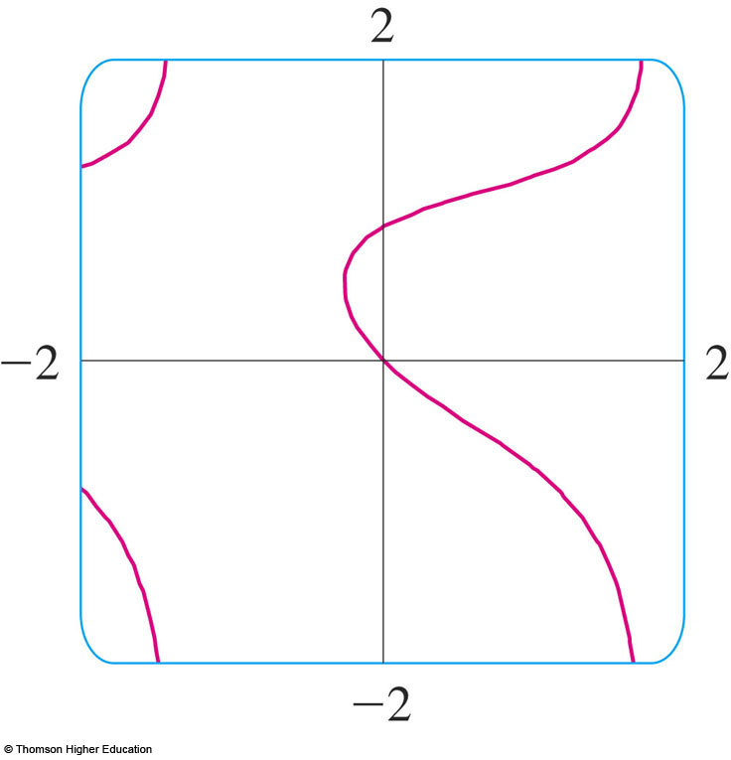
IMPLICIT DIFFERENTIATION
Example 3
The figure, drawn with the implicit-plotting command of a computer algebra system, shows part of the curve sin(x + y) = y² cos x.
  As a check on our calculation,
  notice that y’ = -1 when
  x = y = 0 and it appears that
  the slope is approximately -1
  at the origin.

Slide 31
IMPLICIT DIFFERENTIATION
Example 4
The following example shows how to find the second derivative of a function that is defined implicitly.
Find y” if x⁴ + y⁴ = 16.
  Differentiating the equation implicitly with respect to x, we get 4x³ + 4y³y’ = 0.

Slide 32
IMPLICIT DIFFERENTIATION
E. g. 4—Equation 3
Solving for y’ gives:
To find y’’, we differentiate this expression
for y’ using the Quotient Rule and remembering that y is a function of x:

Slide 33
IMPLICIT DIFFERENTIATION
Example 4
If we now substitute Equation 3 into
this expression, we get:

Slide 34
IMPLICIT DIFFERENTIATION
Example 4
However, the values of x and y must satisfy the original equation x⁴ + y⁴ = 16.
So, the answer simplifies to:

