Slide 1
Analysis of Variance (ANOVA)
PhD Course

Slide 2
Introduction
The analysis of variance models (ANOVA) are flexible statistical tools for analyzing a relationship between a quantitative (numeric or interval scale) variable ( the dependent variable) with one or more non-quantitative variables (the independent variables or factors).
We are wondering whether the independent variables have an effect on the dependent variable and whether this effect is the same or different. The detection of a function-like relationship among the effects and dependent variable is not a goal even if the independent variables are quantitative.

Slide 3
Introduction
The methods of variance analysis are basically may be distinguished in two aspects against regression analysis:
- The independent variables examined may also be qualitative (eg gender, place of residence, etc.)
In such cases, no regression analysis can be performed.
- Even if the dependent variables are quantitative, it is not a goal to explore a function relationship with the independent variable. In this sense, the methods of ANOVA precedes regression analysis. In fact, if we get a positive answer to the existence of the relationship, has sense to look for the nature of this relationship.

Slide 7
One-way ANOVA
The one-way analysis of variance (ANOVA) is used to determine whether there are any statistically significant differences between the means of two or more independent (unrelated) groups (although you tend to only see it used when there are a minimum of three, rather than two groups).

Slide 8
One-way ANOVA

Slide 9
One-way ANOVA

Slide 10


Slide 14


Slide 16
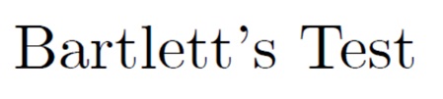

Slide 17
Post Hoc Multiple Comparisions
One popular way to investigate the cause of rejection of the null hypothesis is a Multiple Comparison Procedure. These methods which examine or compare more than one pair of means or proportions at the same time.
• Least Significant Differences (Fisher LSD)
• Tukey (or Tukey-Kramer)
• Bonferroni
• Scheffe

Slide 18
The first post hoc, the LSD test
The original solution to this problem, developed by Fisher, was to explore all possible pair-wise comparisons of means comprising a factor using the equivalent of multiple t-tests.

Slide 19
The LSD test

Slide 20
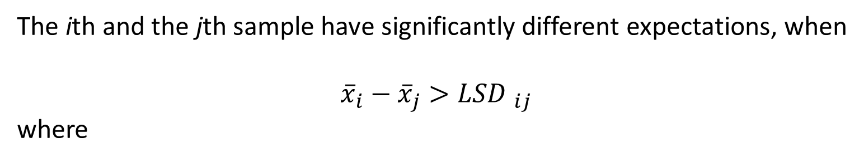
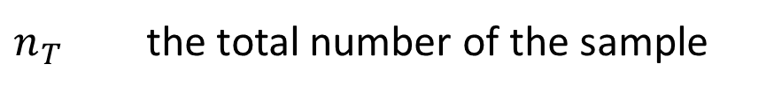
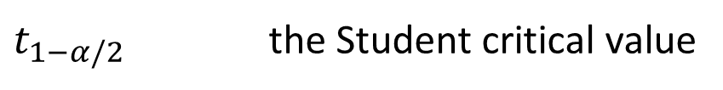
The LSD test
The ith and the jth sample have significantly different expectations, when
$${\overline{x}}_{i}−{\overline{x}}_{j}>{LSD }_{ij}$$
where
$t_{1−α/2}$ the Student critical value
$n_{T}$ the total number of the sample
n_{i}, n_{j} the sample sizes of the compared samples
r is number of samples

Slide 21

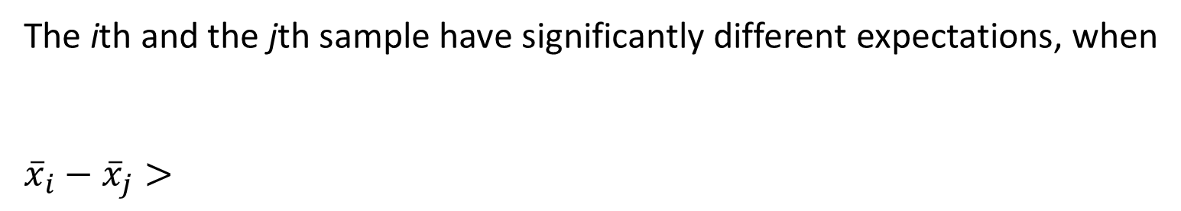

Tukey’s HSD test
The ith and the jth sample have significantly different expectations, when
$${\overline{x}}_{i}−{\overline{x}}_{j}>$$
$${\hat{σ}}_{ε}$$
is the standard deviation of the entire design
n_{i}, n_{j} the sample sizes of the compared samples
$$q_{α;n−r}$$
The critical value of the studendized range distribution

Slide 22
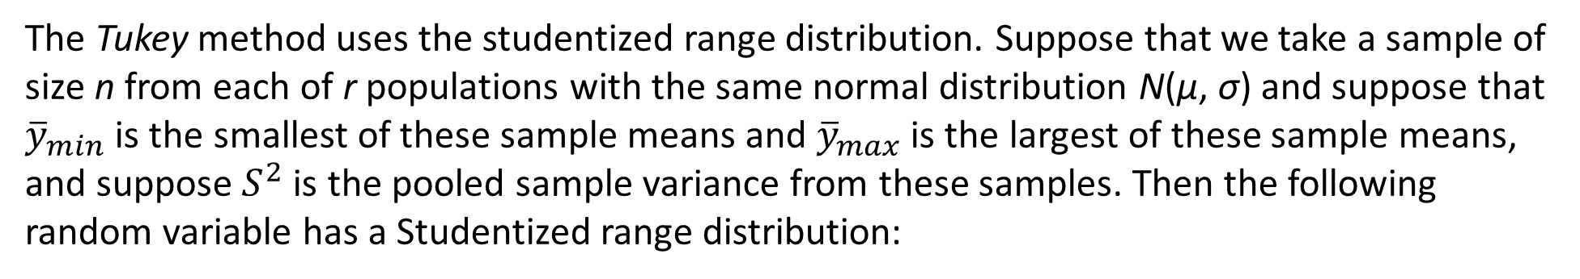
The studentized range (q) distribution
The Tukey method uses the studentized range distribution. Suppose that we take a sample of size n from each of r populations with the same normal distribution N(μ, σ) and suppose that ${\overline{y}}_{min}$ is the smallest of these sample means and ${\overline{y}}_{max}$ is the largest of these sample means, and suppose $S^{2}$ is the pooled sample variance from these samples. Then the following random variable has a Studentized range distribution:
The distribution of q has been tabulated and appears in many textbooks on statistics.

Slide 23
Bonferoni Method
For all $g=\frac{1}{2}r\left(r−1\right) pairwise comparisons, minimum significant difference is$
Confidence interval for the expectation difference is
• Sacrifices slightly more power than TUKEY, but can be applied to any set of contrasts or linear combinations (useful in more situations than Tukey).
• Is usually better than Tukey if we want to do a small number of planned comparisons.

Slide 24
Scheffe Comparisons
Scheffe’s procedure is perhaps the most popular of the post hoc procedures, the
most flexible, and the most conservative.
For pair-wise comparisons, Scheffe’s can be computed as follow

Slide 26


Slide 27


Slide 28
Calculating means and means of the squares:

Slide 29
Calculating variances:

Slide 31
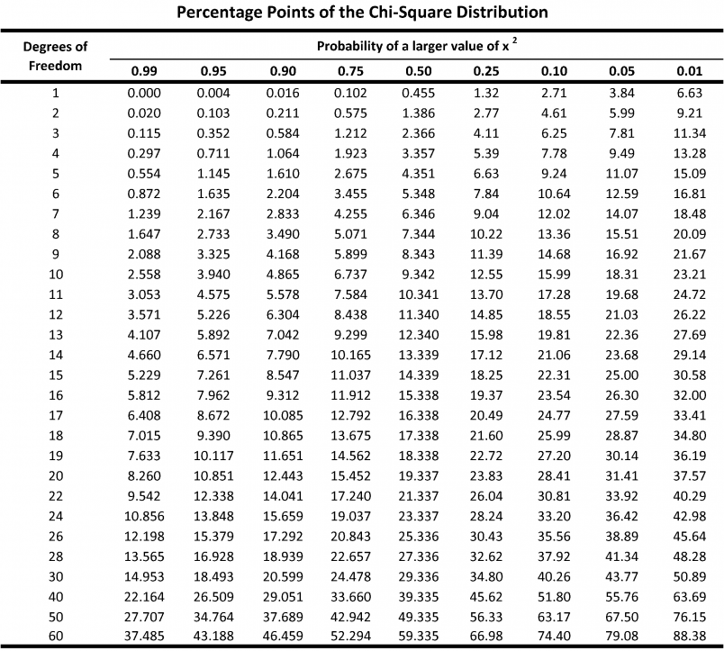

Slide 34
Later we will see an example:
Is the life satisfactory affected by gender or age?
The problem can be sold in a two factors ANOVA model.

Slide 37
The average value for the i-th level of the first factor
The average value for the j-th level of the second factor
Total mean of the observations
Sample sizes belonging to the means

Slide 38
Total Sum of Squares (TSS)
Square sum what can be explained by the first factor
Square sum what can be explained by the second factor
The square sum of random error

Slide 39
It can be show, that
If the null hypothesis is true
follows F distribution with df1=L-1 and df2=n-K-L+2
Where
and
Thus, if the value of the test statistic is significant, the null hypothesis is accepted, ie the first factor has no effect on the target variable X.

Slide 40
The procedure is also suitable for controlling null hypothesis ,
but in this case shall write into the numerator.
Then the test statistic is distributed F with df1=K-1 and df2=n-K-L+2 if the null hypothesis is true.
If the original null hypothesis is rejected then the confidence interval for the differences between the first factor levels, i.e. a_{i}-a_{j} (or g_{i}-g_{j}), can be edited with two samples t-test.

Slide 42
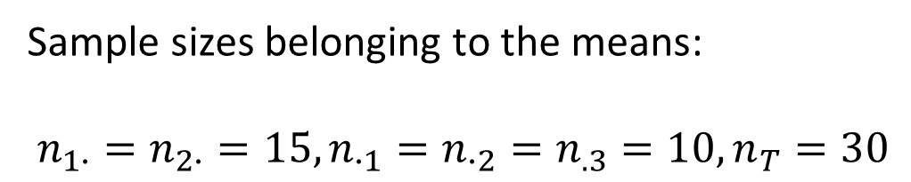
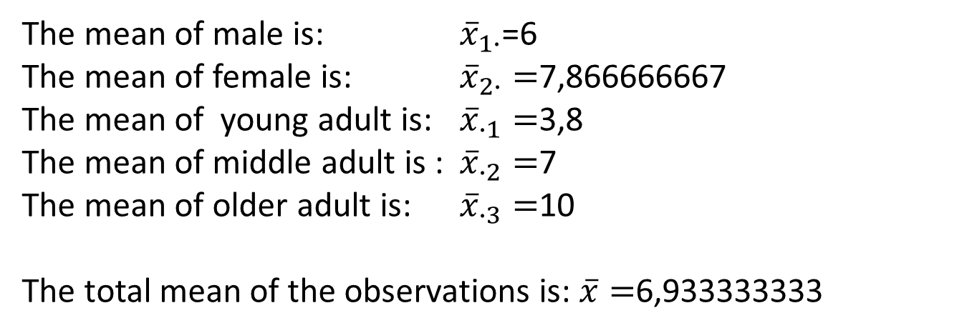
The mean of male is: ${\overline{x}}_{1∙}$=6
The mean of female is: ${\overline{x}}_{2∙}=$7,866666667
The mean of young adult is: ${\overline{x}}_{∙1}=$3,8
The mean of middle adult is : ${\overline{x}}_{∙2}=$7
The mean of older adult is: ${\overline{x}}_{∙3}=$10
The total mean of the observations is: $\overline{x}=$6,933333333
Sample sizes belonging to the means:
$n_{1∙}=n_{2∙}=15, n_{∙1}=n_{∙2}=n_{.3}=10,n_{T}=30$

Slide 43
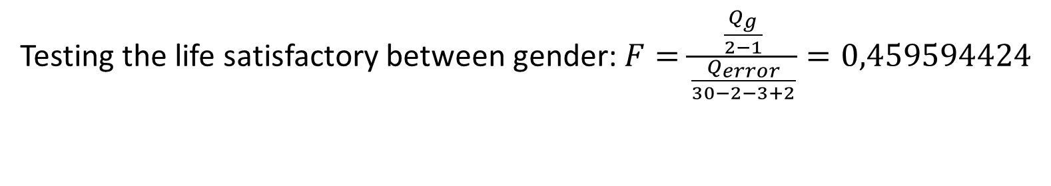
Total Sum of Squares (TSS): Q=265,8666667
Square sum what can be explained by the first factor (the gender): Q_{g}=3,484444444
Square sum what can be explained by the second factor (the age): Q_{a}=57,68
The square sum of random error: Q_{error} =Q-Q_{g}-Q_{a} = 204,7022222
Testing the life satisfactory between gender:
The critical value: $F_{0,05,1,227}=4,2⟹the null hypothesis is accepted!$

Slide 44

Testing the life satisfactory between age categories:
$$F=\frac{\frac{Q_{a}}{3−1}}{\frac{Q_{error}}{30−2−3+2}}=3,803964566$$
The critical value: $F_{0,05,2,27}=3,35⟹the null hypothesis is rejected!$

Slide 45
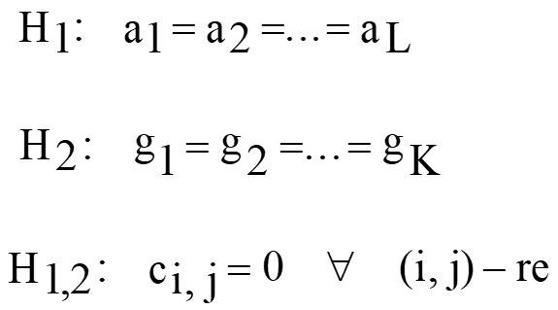
Two-way ANOVA with interaction
If we assume interaction between the two nominal factors, then the theoretical expected value of cell (i, j) is changed to:
c_{i}, _{j} denotes exactly that the effects at (i, j) are mutually reinforcing or weakening. The method is suitable for simultaneously controlling three hypotheses:

Slide 46
Two-way ANOVA with interaction
To decide the hypotheses, the following statistics are required:
Mean of the total sample
Mean of the i-level at the first factor
Mean of the j-level at the second factor

Slide 47
Two-way ANOVA with interaction
Mean of the (i, j) cell
Total sum of squares (TSS)
Average number of elements in the cells

Slide 48

Two-way ANOVA with interaction
Square sum what can be explained by the first factor
Square sum what can be explained by the second factor
Square sum what can be explained by the interactions

Slide 49
Two-way ANOVA with interaction
First we test the H_{1,2} hypothesis. If it is true
Must follow F distribution with df1=(L-1)(K-1) and df2=K×L×(N-1).
If this ratio is significantly higher than the critical value, interaction can be accounted for as a fact. In this case, it is possible to edit confidence intervals for c_{i,} _{j} members.

Slide 50
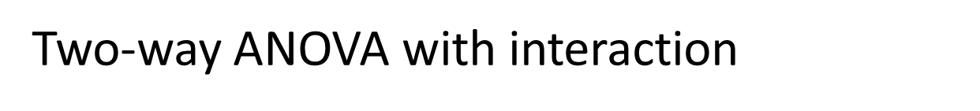
If we accept H₁₂ hypothesis, ie the interactions isn’t detected, we add Q_{A,B} to Q_{b} and we count with
Q_{b*=}Q_{A,B+}Q_{b}
Then we check eg H₂ hypothesis with the test statistic
If the hypothesis is true then it must follow F distribution with df1=K-1 and
df2= K×L×N-L-K+1

Slide 51
The control of the hypothesis H₁ can be performed with test statistic
as in the previous ones. Now the critical value determined from the F table where df1=L-1, df2=K×L×N-L-K+1

Slide 52
Latin square design
The method of the Latin squares is a three-factors, but incomplete experimental layout model. Suppose that our target variables is correlated with three category variables, each with r> 1 levels. If we follow the method of random blocks then we should at least one observation for each level combination, ie we should do at least r³ measurements. However, with the Latin squares method, we can already make r² data.
The Latin square design is for a situation in which there are two extraneous sources of variation. If the rows and columns of a square are thought of as levels of the two extraneous variables, then in a Latin square each treatment appears exactly once in each row and column.

Slide 53
Latin square design
Definition: The rxr type matrices, each row and column of which are permutations of numbers 1, 2, ..., r are called Latin squares.
Two 5×5 latin squares

Slide 54
Latin square design
Consider a rxr type H = (h_{ij}) Latin square. In addition to the cell for each
(i, j, h_{ij}) ( i, j = 1, 2, ..., r,) of the three factors, observe the target variable. Mark them with X_{ijh}! We assume that the variable X_{ijh} is completely independent of normal distribution and EX_{ijh} = f_{h} + b_{i} + c_{j}, σX_{ijh} = σ . The expected value of the target variable is influenced by all three factor additive way.
We want to decide on the null hypothesis that the levels of the third factor have no effect on the target variable, i.e.
H₀: f₁=f₂=…=f_{r}

Slide 55

Mean of the ith level of the first factor
Mean of the jth level of the second factor
Mean of the hth level of the third factor
Mean of the total sample

Slide 56
Total sum of squares
Sum of squares explained by first factor
Sum of squares explained by second factor
Sum of squares explained by third factor

Slide 57
It can be shown that Q=Q₁+Q₂+Q₃+Q₄.
Deegre of freedom of Q is r²-1
Deegres of fredom of Q₁, Q₂, Q₃ is r-1
Deegre of freedom of Q₄ is (r-1)(r-2)
While r²-1=3(r-1)+(r-1)(r-2) and in Q₃ the expectations of the linear combinations are zeros if the null hypothesis is true, the Fisher-Cohran theorem applicable.

Slide 58
If the null hypothesis is true
follows F distribution with df1=r-1 and df2=(r-1)(r-2)
If we reject the null hypothesis we can edit confidence intervals for the differencies f_{i}-f_{j} with distribution table of t_{(r-1)(r-2)} .

Slide 59
Advantages of Latin square
Greater power than the RBD when there are two external sources of variation.
Easy to analyze.
Disadvantages
The number of treatments, rows and columns must be the same.
Squares smaller than 5×5 are not practical because of the small number of degrees of freedom for error.
The effect of each treatment must be approximately the same across rows and columns.

Slide 60
Latin square example
Four machines are to be tested to see whether they differ significantly in their ability to produce a manufactured part. Different operators and different time periods in the work day are known to have an effect on production. A Latin square design is used in which 4 operators are “columns” and 4 time periods are “rows.” Machines are assigned at random to the 16 cells of the square with the restriction that each machine is used only once by each operator and in each time period. The following Latin square was obtained.

Slide 61
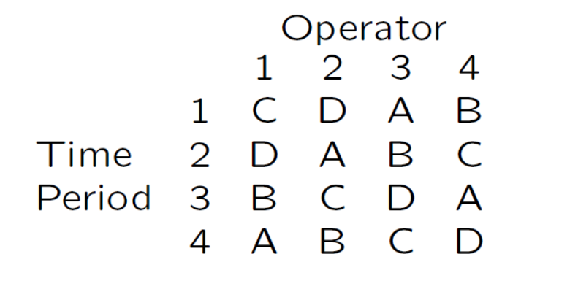
The null hypothesis is accepted

